Slide 1
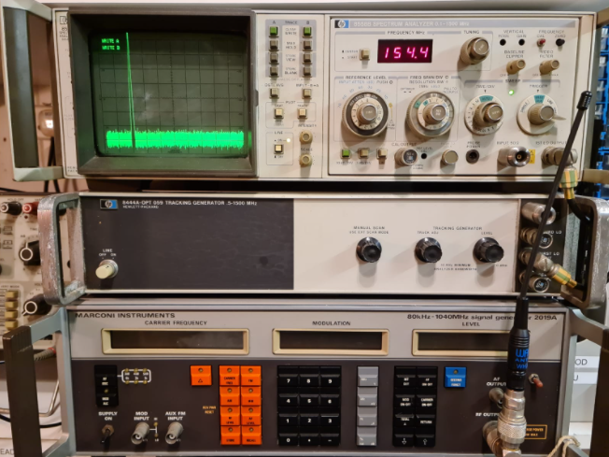
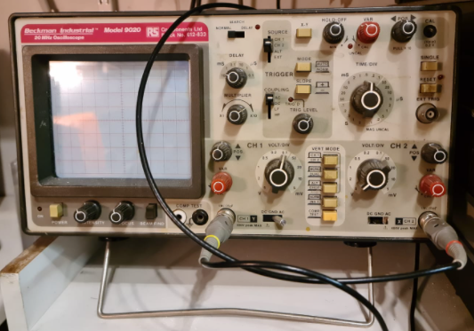
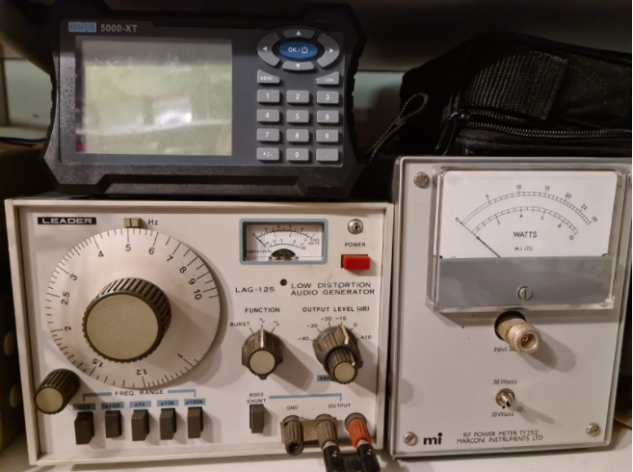
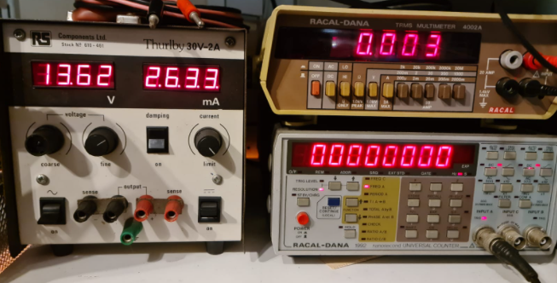
Test Equipment for Radio Amateurs
Mike Gathergood, G4KFK September 2022

Slide 2
Test equipment for Radio Amateurs
As radio amateurs, we may have an interest in measurement of various aspects of our station, such as:
Transmitted power (including peak envelope power for SSB)
Antenna health (VSWR or return loss)
Transmission line health (distance to fault and cable losses)
Ability to transmit into a non-radiating load for off-air testing
Ability to get a low-level sample of our transmitted signal
Frequency of our transmission
Spectral purity of our transmission
Sensitivity of our receiver
Those interested in electronics construction will also need:
Accurate measurement of voltage, current and DC resistance
Measurement of capacitance and inductance
A wide range of DC supply voltages
An oscilloscope
Mike Gathergood, G4KFK September 2022

Slide 3
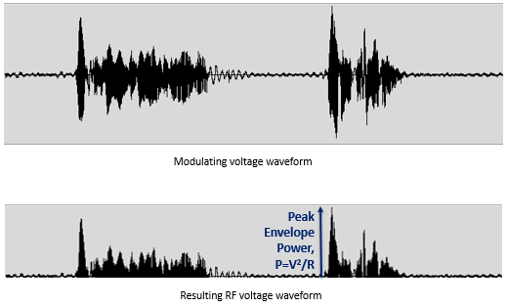
Transmitted Power
UK amateur radio licences include various power limits, for example a full licensee may radiate 32W (15dBW) peak envelope power in the upper part of the 160m band, 1.85 to 2MHz.
Measurement of CW or FM power is relatively easy, and there are many products on the market which can give us a sufficiently accurate reading, typically ±5% to ±10%
Measurement of an SSB signal is more complicated. The RF power varies according to the modulating signal (typically speech). The moving coil meter in a simple power or VSWR meter cannot react quickly enough to show the peak envelope power.
Mike Gathergood, G4KFK September 2022

Slide 4
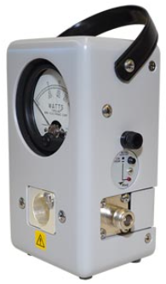
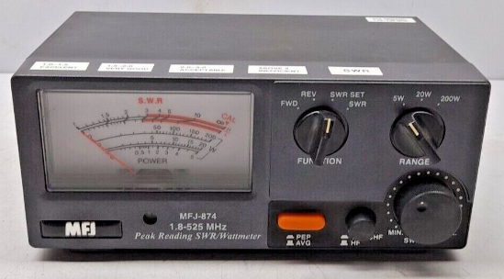
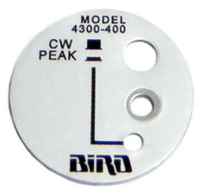
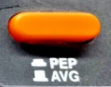
Transmitted Power
The problem of measuring peak envelope power can be solved with a simple electronic circuit which can “hold” the peak level.
Mike Gathergood, G4KFK September 2022

Slide 5
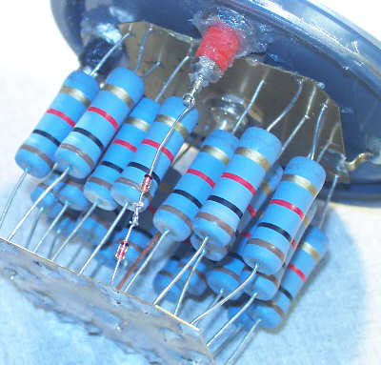
Dummy Load
Ideally, we should have a good 50Ω non-reactive non-radiating load when measuring transmitted power. For the HF bands, it’s possible to make one using a combination of resistors to achieve a total of 50Ω resistance, and with sufficient power.
For example, twenty 1kΩ ½W resistors in parallel will give us a 50Ω load capable of 10W. Immersing the resistors in a non-conductive coolant will increase the power handling.
Mike Gathergood, G4KFK September 2022

Slide 6
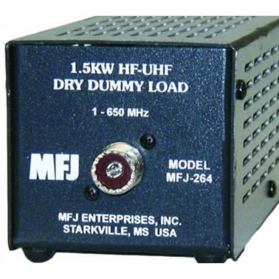
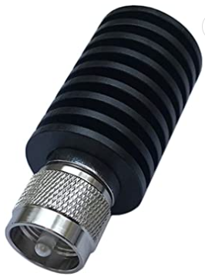
Dummy Load
A home-made load for high power, and/or frequencies above 30MHz is not so easy. Fortunately, commercial loads are inexpensive, and readily available new or used.
25W load for DC to 1GHz, £20 on Amazon.
1.5kW (peak) load for DC to 650MHz, £105 from amateur radio shops.
Mike Gathergood, G4KFK September 2022

Slide 7
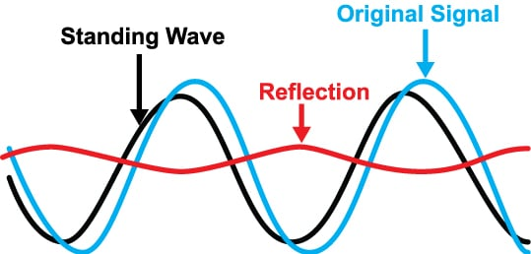
Antenna VSWR
VSWR (voltage standing wave ratio) is a measure of the quality of the “match” between the output of the transmitter and the antenna system. For maximum power transfer, the source impedance should be the same as the load impedance, typically 50 ohms.
A “mis-match” will cause reflection to travel from the antenna back towards the transmitter. The forward power and reflected power combine to produce a standing wave. In the most extreme cases, the standing wave may exceed safe voltages for the coaxial cable, connectors, and components in the output of the transmitter.
Mike Gathergood, G4KFK September 2022

Slide 8
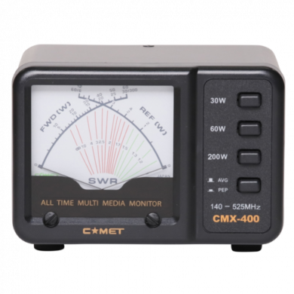
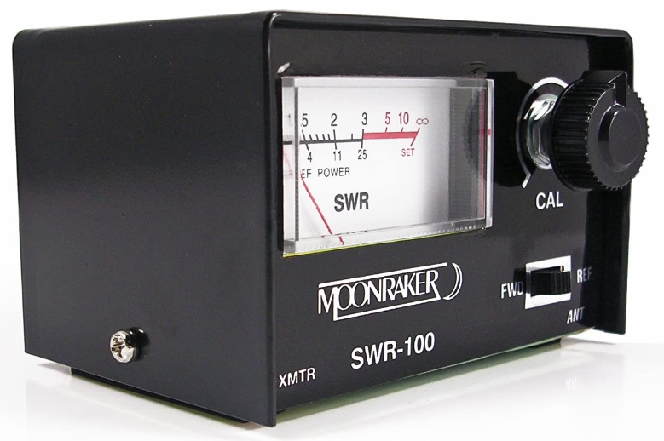
Antenna VSWR
It’s possible to derive the VSWR using a single meter, but the most user-friendly VSWR meters have two separate meters. These may be combined into a single housing, as a “cross-needle” device.
Mike Gathergood, G4KFK September 2022

Slide 9
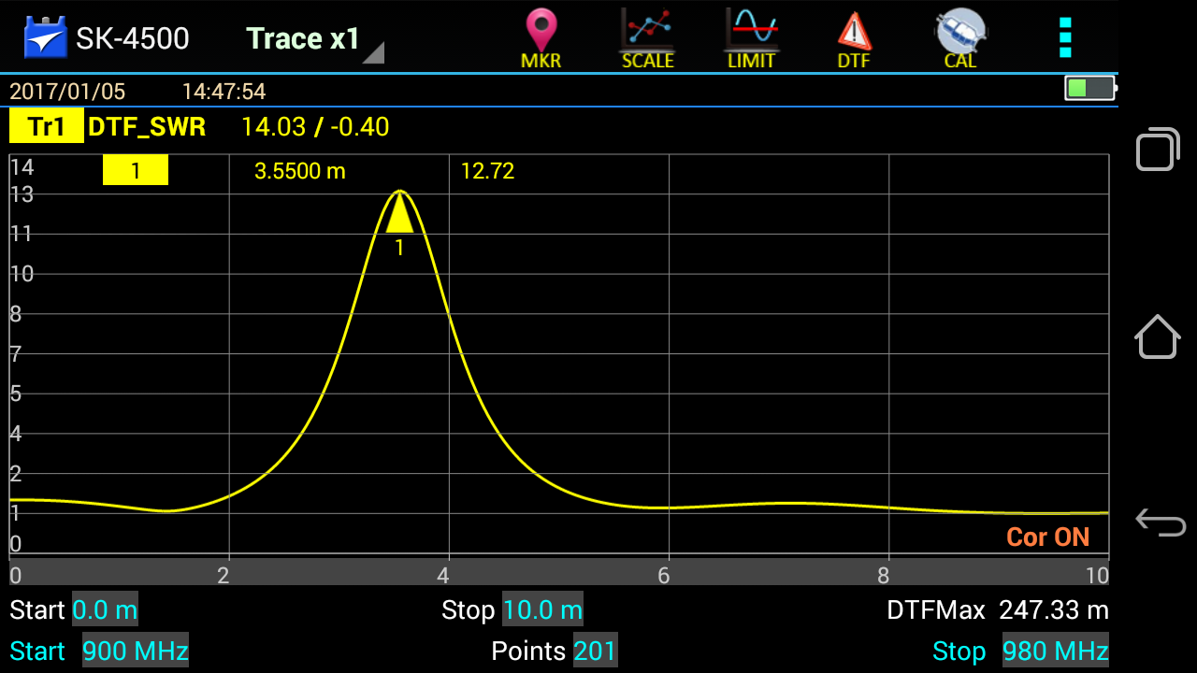
Coaxial Cable Faults
A short or open circuit in a coaxial cable are easy to spot, as both will give rise to a high VSWR. The fault may be found by visual inspection, though a “distance to fault” measurement with a VNA (vector network analyser) is more convenient.
Mike Gathergood, G4KFK September 2022

Slide 10
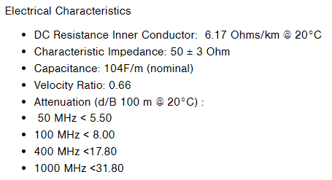
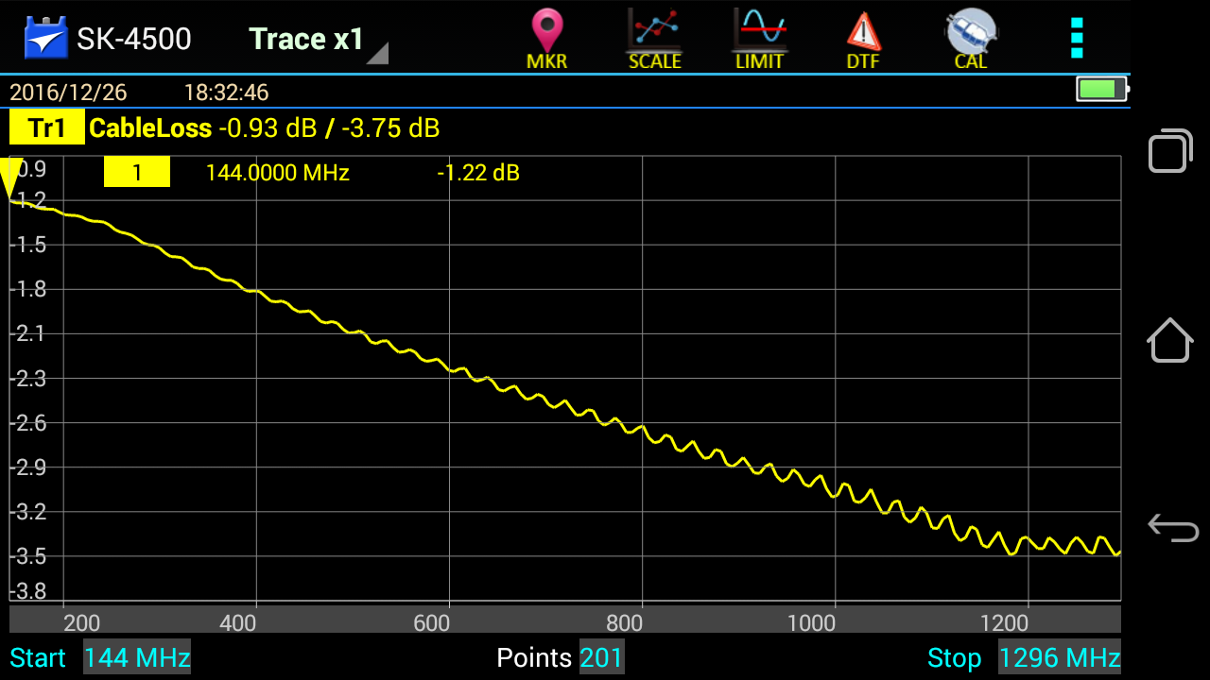
Coaxial Cable Faults
More difficult to spot is moisture ingress. This causes the losses in the cable to increase – which can make the VSWR appear to decrease. Again, a VNA can be used to measure the cable loss, and compare the measured values with the cable manufacturer’s specifications.
Mike Gathergood, G4KFK September 2022

Slide 11
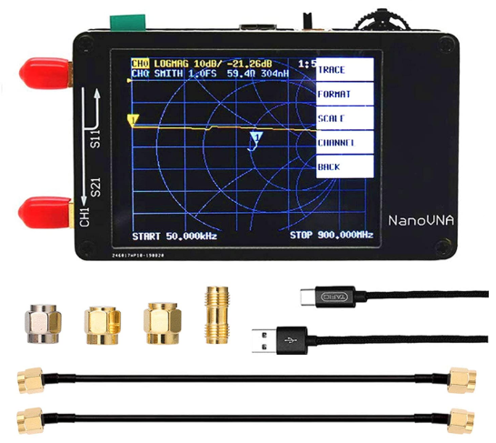
Vector Network Analyser
Professional VNAs can cost many thousand of pounds. Fortunately an amateur budget DC-1.5GHz VNA is available on Amazon.
NanoVNA Vector Network Analyser, £49 on Amazon.
Mike Gathergood, G4KFK September 2022

Slide 12
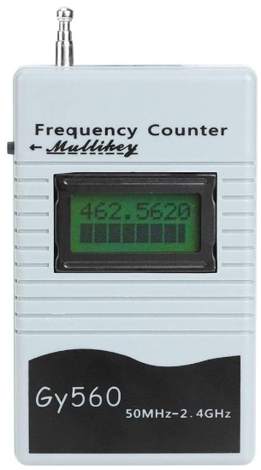
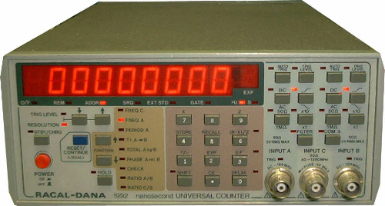
Frequency Measurements
Accurate frequency measurement is not so critical for those using modern commercially-made transceivers. For those using home-made transmitters, or modified PMR (eg Pye, Storno, Motorola, etc…) radios, it’s important to ensure that the signal is where it’s supposed to be, and definitely within an amateur band. New and used digital frequency meters are inexpensive, and readily available.
Handheld 2.4GHz frequency meter, £23 on Amazon.
Racal-Dana 1992 1.3GHz frequency meter, typically £100 on eBay.
Mike Gathergood, G4KFK September 2022

Slide 13
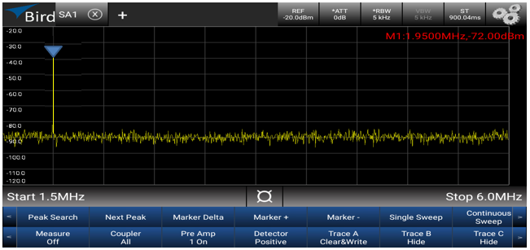
Spectral Purity
But knowing the frequency may not be enough. For example, a 1.95MHz AM transmitter with insufficient output filtering may also radiate significant harmonics, which will fall outside any amateur band.
No significant output on 2nd (3.9MHz) or 3rd (5.85MHz) harmonics.
Mike Gathergood, G4KFK September 2022

Slide 14
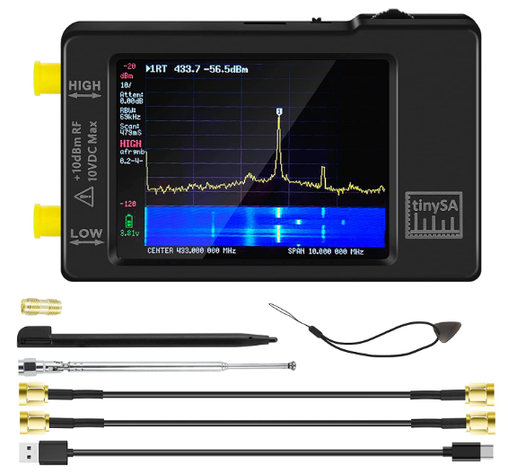
Spectrum Analysers
Professional spectrum analysers can cost many thousand of pounds. Fortunately an amateur budget 1GHz spectrum analyser is available on Amazon.
TinySA Spectrum Analyser, £90 on Amazon.
Mike Gathergood, G4KFK September 2022

Slide 15
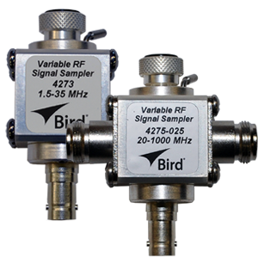
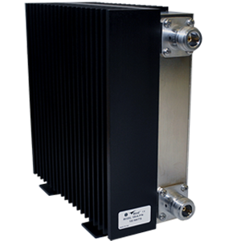
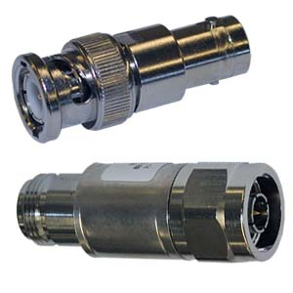
Samplers and/or Attenuators
The maximum input power allowed for a spectrum analyser is typically +10dBm (10mW). It is therefore important to use either a sampler or attenuator between the transmitter and the spectrum analyser. For example, a 100W (+50dBm) transmitter will require at least 40dB of attenuation in order to be safely connected to a spectrum analyser. The attenuator must be capable of dissipating the full output power of the transmitter.
Mike Gathergood, G4KFK September 2022

Slide 16
Receiver Sensitivity
This is probably of less importance with recent commercially-made equipment, but those of us with older equipment, or who are modifying non-amateur equipment to use in the amateur bands need some idea of whether the receiver is performing to published specifications.
This requires a signal generator with either a variable output level, or a fixed level output with a set of external attenuators.
In addition to generating an unmodulated carrier wave, AM and FM modulation are useful features.
Great care should be taken when connecting a signal generator to a transceiver to ensure that accidental transmission cannot occur, as this could damage the output stages of the signal generator.
RF signal generators are available new and used.
Mike Gathergood, G4KFK September 2022

Slide 17
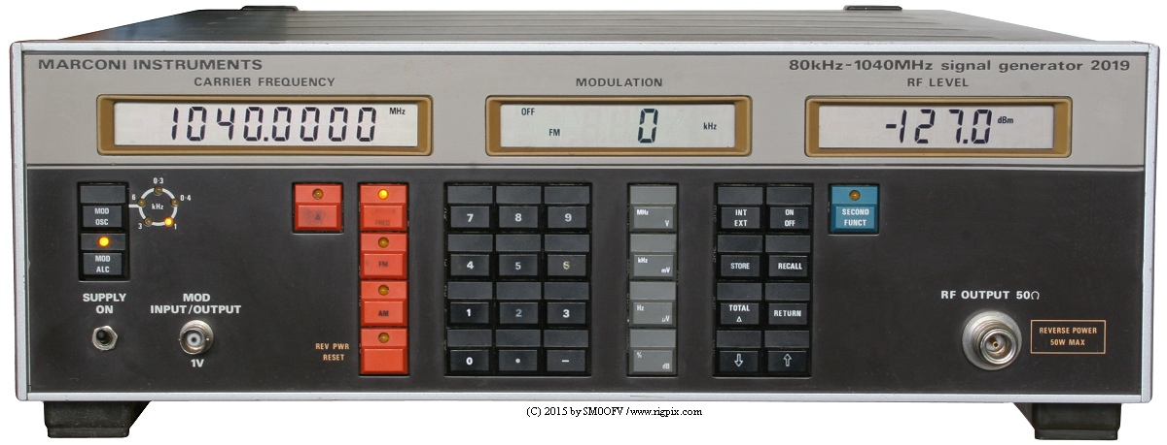
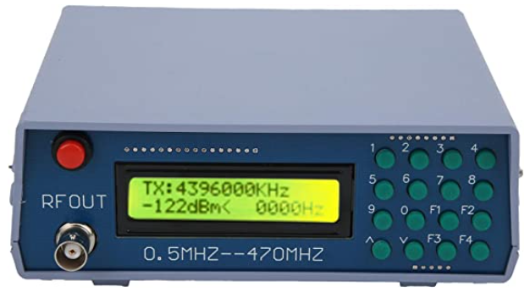
RF Signal Generators
Marconi 2019A
80kHz to 1040MHz,
CW/AM/FM with variable deviation/depth.
-127 to +13dBm.
Internal audio oscillator and external modulation input.
No-name Chinese RF signal generator.
500kHz to 470MHz, -132 to -70dBm
800Hz tone modulation, FM only.
£110 on Amazon.
Mike Gathergood, G4KFK September 2022

Slide 18
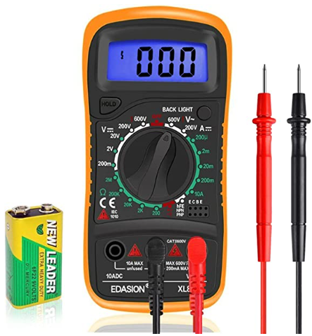
Multimeter
Typically providing measurement of DC and AC voltage and current, and resistance, handheld units are cheap and readily-available. Some meters may also feature an audible continuity test, and transistor testing.
Edasion digital multimeter.
Includes audible continuity tester, and transistor gain measurements.
£11 on Amazon.
Mike Gathergood, G4KFK September 2022

Slide 19
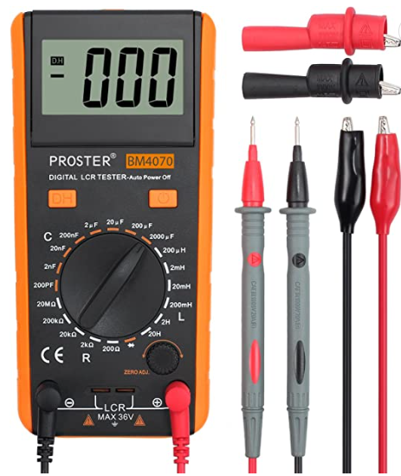
Component Testing
As components get smaller (or our eyesight gets worse?), the ability to check the values of resistors, capacitors and inductors may be useful.
Proster BM4070 LCR Meter.
£28 on Amazon.
Mike Gathergood, G4KFK September 2022

Slide 20
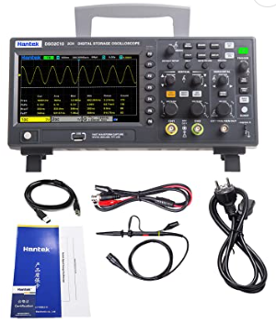
Oscilloscopes
Oscilloscopes used to be expensive, but use of LCD screens instead of CRTs, and modern digital electronics allow RF bandwidth units with storage within hobbyist’s budgets.
Hantek 100MHz 2 Channel Storage Scope.
£190 on Amazon.
Mike Gathergood, G4KFK September 2022

Slide 21
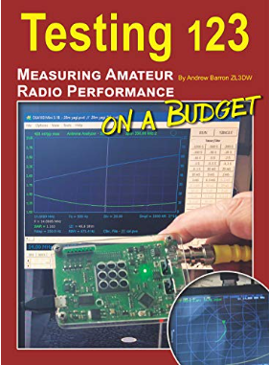
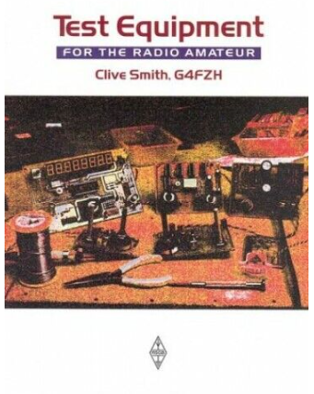
Further Reading
Test Equipment for the Radio Amateur,
by Clive Smith, G4FZH.
Testing 123, by Andrew Barron, ZL3DW
£15 on Amazon, or £8 on Kindle.
Mike Gathergood, G4KFK September 2022

