Slide 1
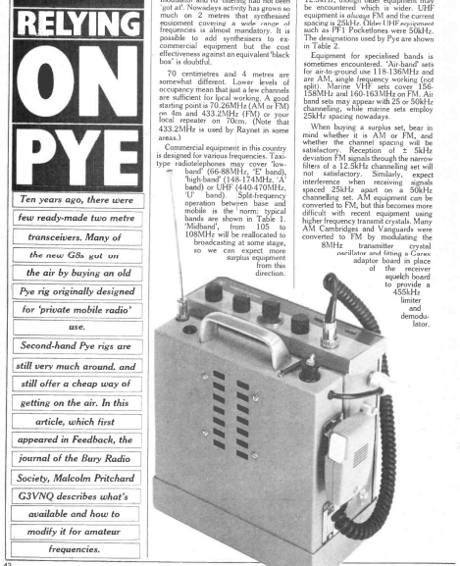
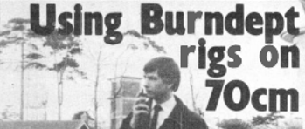
Using Motorola Radios on 4m, 2m & 70cm
The February 1984 issue of Amateur Radio magazine featured an article by G3VNQ about re-purposing Pye radios for 4m, 2m and 70cm.
The March 1984 issue featured an article about using Burndept police radios on 70cm.
I though it was about time someone did the same for Motorola radios…
Mike Gathergood, G4KFK September 2022

Slide 2
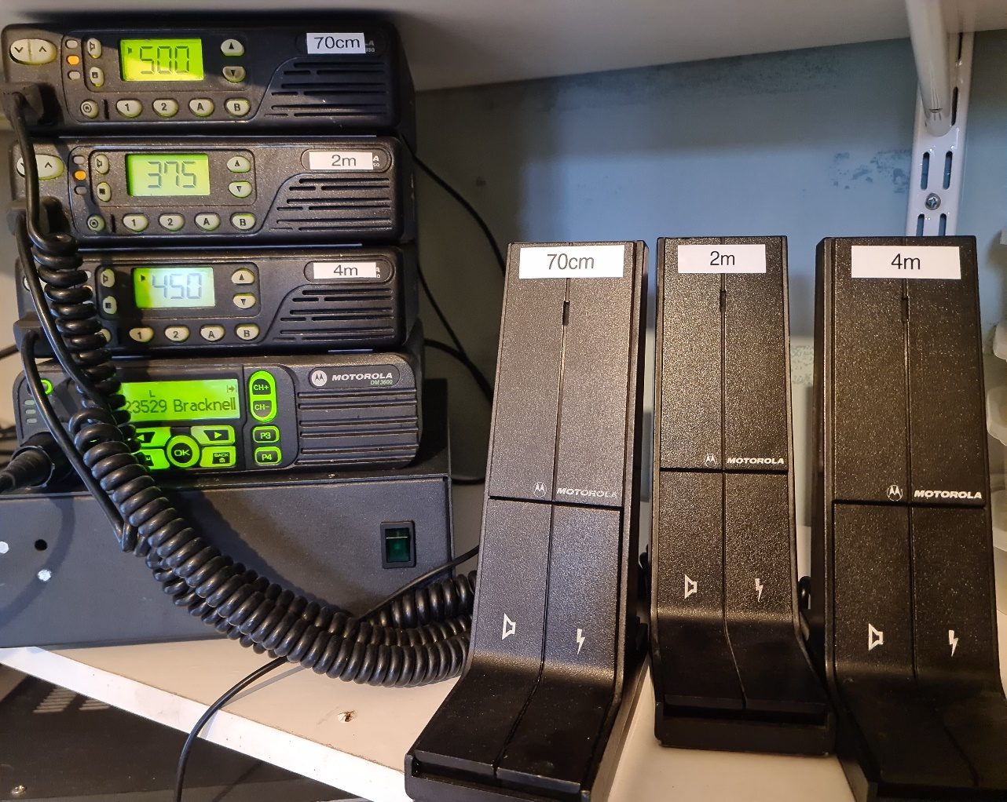
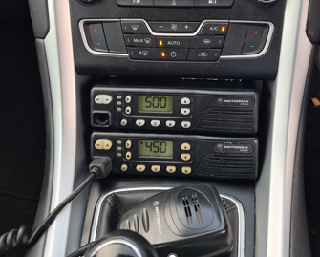
Mobile Radios – the GM350
128 channels, with scan function and 3 digit display.
4 channel version with no display.
VHF Low, 68-88MHz, inc. 4m.
VHF High, 136-174MHz, inc. 2m.
UHF, 403-470MHz, inc. 70cm.
CTCSS for repeaters.
5-25W output.
Mike Gathergood, G4KFK September 2022

Slide 3
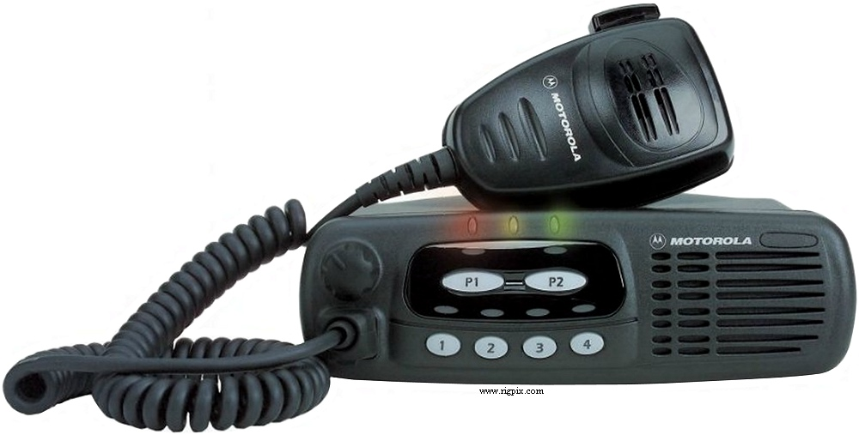
Mobile Radios – the GM340
Basic 4 channel radio.
VHF high, 136-174MHz, inc. 2m.
UHF, 403-470MHz, inc. 70cm.
CTCSS for repeaters.
5 – 25W output.
Mike Gathergood, G4KFK September 2022

Slide 4
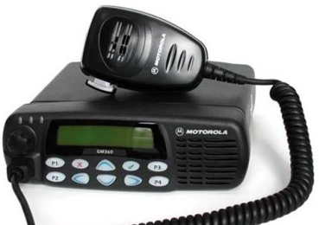
Mobile Radios – the GM360/GM380
255 channels, with 14-character alphanumeric display.
VHF high, 136-174MHz, inc. 2m.
UHF, 403-470MHz, inc. 70cm.
CTCSS for repeaters.
5 – 25W output.
Mike Gathergood, G4KFK September 2022

Slide 5
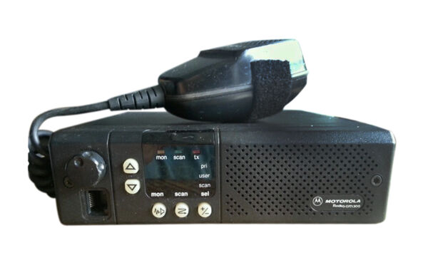
Mobile Radios – the GM300
8 or 16 channels, with 2 digit display
VHF high, 146-174MHz, but can be “tricked” into working on 2m.
UHF, 438-470MHz, deaf on 70cm, best avoided.
CTCSS for repeaters.
5 – 25W output.
Mike Gathergood, G4KFK September 2022

Slide 6
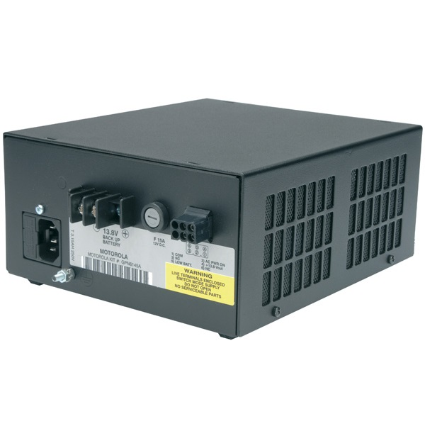
Base Station Operation
Any of the mobile radios can be used as a base station, with the addition of a suitable power supply. In addition to providing 10A at 13.8V for the radio, Motorola’s GPN6145A can also float-charge a car battery, and switch over to the battery if the AC fails.
Mike Gathergood, G4KFK September 2022

Slide 7
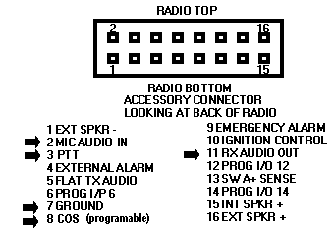
GM300/340/360/380 Accessory Port
Mobile radios are fitted with an accessory port, with some fixed and programmable function pins.
Applications include:
Repeaters
Packet TNCs
Remote channel change
Auto on with car ignition
Mike Gathergood, G4KFK September 2022

Slide 8
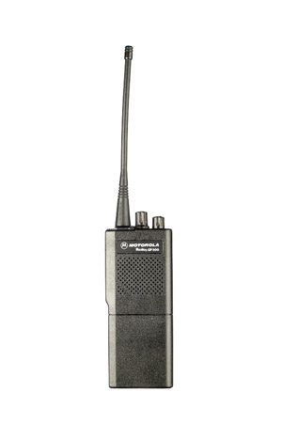
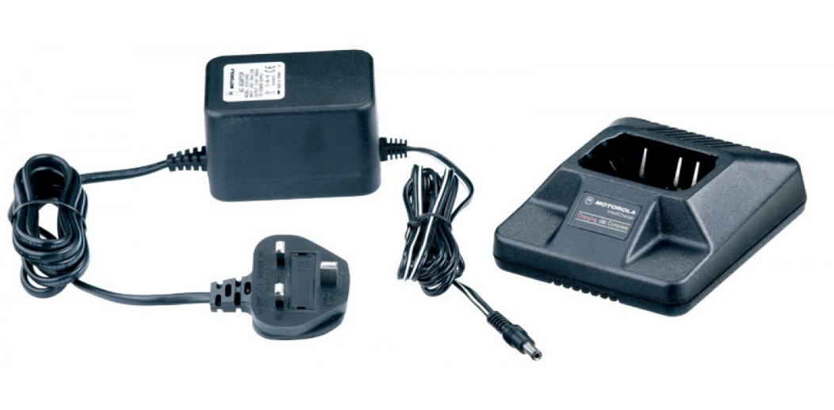
Portable Radios – the GP300
2, 4, 8 and 16 channel versions.
VHF High, 146-174MHz, but can be tricked into working on 2m.
UHF version is 438-470MHz, very deaf on 70cm and best avoided!
CTCSS for repeaters.
5W output (VHF), 4W output (UHF).
Mike Gathergood, G4KFK September 2022

Slide 9
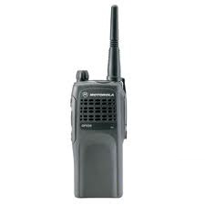
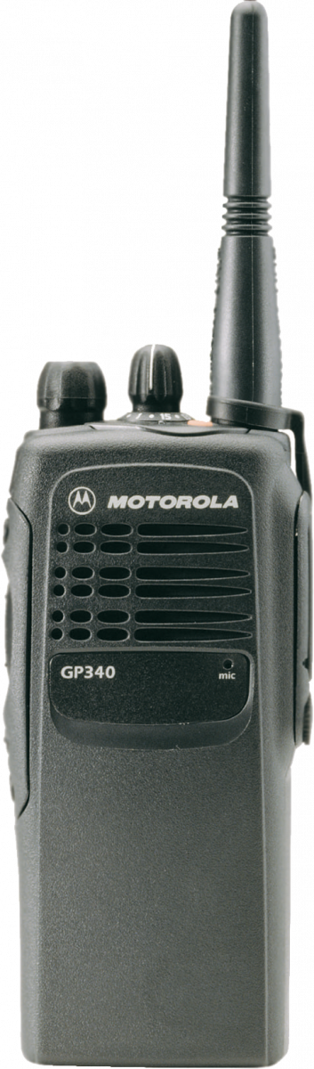
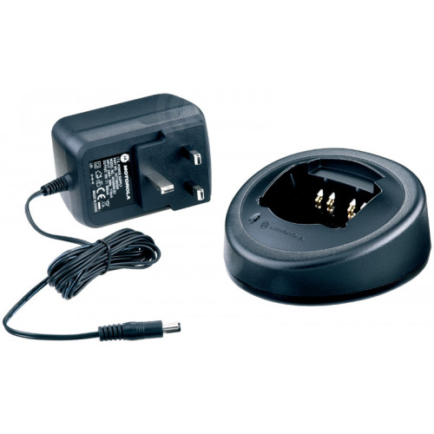
Portable Radios – the GP320/340
GP320 = single channel
GP340 = 16 channels.
VHF High, 136-174MHz, includes 2m.
UHF version is 403-470MHz, includes 70cm.
CTCSS for repeaters.
5W output.
Mike Gathergood, G4KFK September 2022

Slide 10
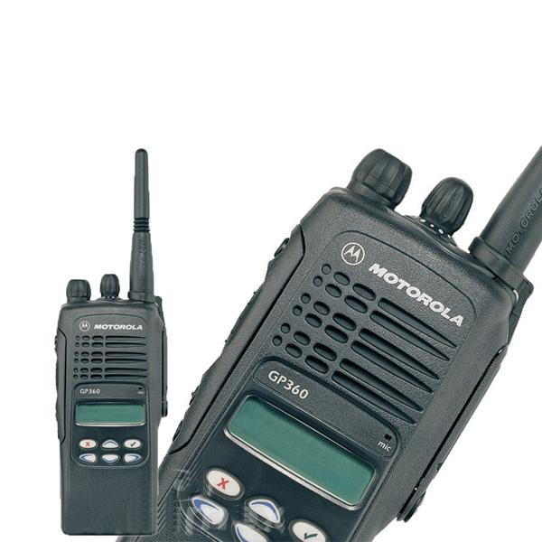
Portable Radios – the GP360
255 channels with display.
VHF High, 136-174MHz, includes 2m.
UHF version is 403-470MHz, includes 70cm.
CTCSS for repeaters.
5W output.
Mike Gathergood, G4KFK September 2022

Slide 11
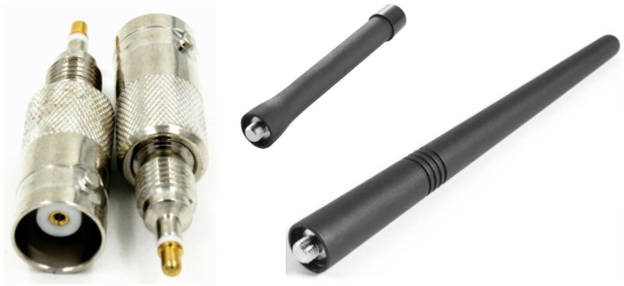
Portable Radios – antennas
GP300, GP340 and GP360 have a proprietary threaded antenna connector.
Replacement antennas readily available on eBay.
Adapters to BNC readily available on eBay.
Mike Gathergood, G4KFK September 2022

Slide 12
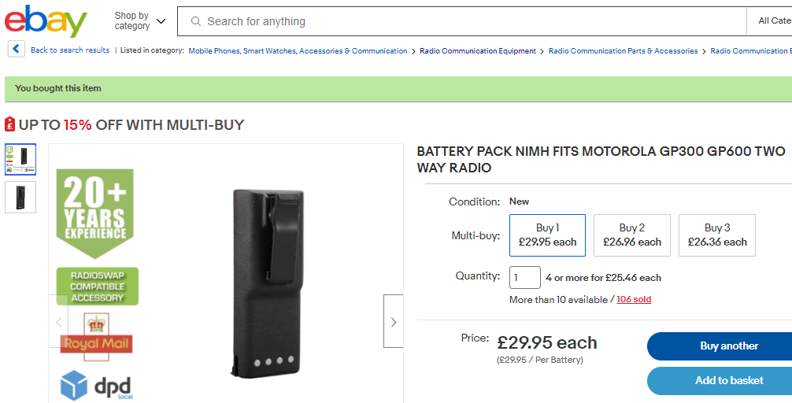
Portable Radios – batteries
Motorola and good-quality after-market batteries for GP300, GP340 and GP360 are readily available on eBay.
Mike Gathergood, G4KFK September 2022

Slide 13

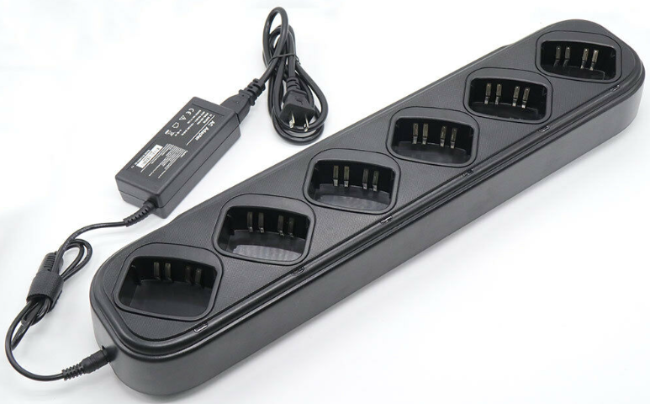
Portable Radios – chargers
Single and multiple chargers, and battery eliminators, are readily available:
Mike Gathergood, G4KFK September 2022

Slide 14
Decoding the Model Numbers, GM350
M08KHE4AA2AN
F = 68-88MHz .
K = 136-174MHz.
R = 403-470MHz.
E = 4 channel, no display.
F = 128 channel, with display.
4 = 12.5kHz channel spacing.
6 = 25kHz channel spacing.
Mike Gathergood, G4KFK September 2022

Slide 15
Decoding the Model Numbers, GM340/60/80
MDM25KHC9AN5AE
K = 136-174MHz.
R = 403-470MHz.
C = GM340, 4 channel, no display.
F = GM360, 255 channel, alphanumeric display.
N = GM380, 255 channel, alphanumeric display.
Mike Gathergood, G4KFK September 2022

Slide 16
Decoding the Model Numbers, GM300
M33GMC00D2A
0 = 10W.
3 = 25W.
4 = 45W.
3 = VHF, 146-174MHz.
4 = UHF, 438-470MHz.
0 = 12.5kHz channel spacing.
2 = 25kHz channel spacing.
0 = 8 channels.
9 = 16 channels.
Mike Gathergood, G4KFK September 2022

Slide 17
Decoding the Model Numbers, GP320/340/360
MDH25KDC4AN3AE
K = 136-174MHz.
R = 403-470MHz.
C = 1W for ATEX (intrinsically safe).
D = 5W (VHF), 4W (UHF).
C = GP320/GP340.
F = GP360.
4 = 12.5kHz channel spacing.
6 = 25kHz channel spacing.
9 = programmable channel spacing.
Mike Gathergood, G4KFK September 2022

Slide 18
Decoding the Model Numbers, GP300
P93YPC00D2AA
2 = 1W on VHF/UHF.
9 = 5W VHF or 4W UHF.
3 = VHF, 146-174 (software cheat will allow down to 144MHz).
4 = UHF, 438-470MHz.
0 = 12.5kHz channel spacing.
2 = 25kHz channel spacing.
0 = CTCSS and DPL signalling only.
9 = 5 tone selective calling.
A = 2 channels.
C = 16 channel.
D = 8 channels.
Mike Gathergood, G4KFK September 2022

Slide 19
Programming Software
All these radios had programming software for DOS, and required a “proper” serial RS-232 interface. Do not use a USB/serial adapter. It probably won’t work, and it might “brick” the radio.
I have the software for all the radios described.
GM340, GM350, GM360 and GM380 programme via the RJ-45 mic socket.
GP300 programmes via a device which temporarily replaces the battery. An external 12V supply is required.
GP340 and GP360 programme via the external mic/headset connector.
Mike Gathergood, G4KFK September 2022

Slide 20
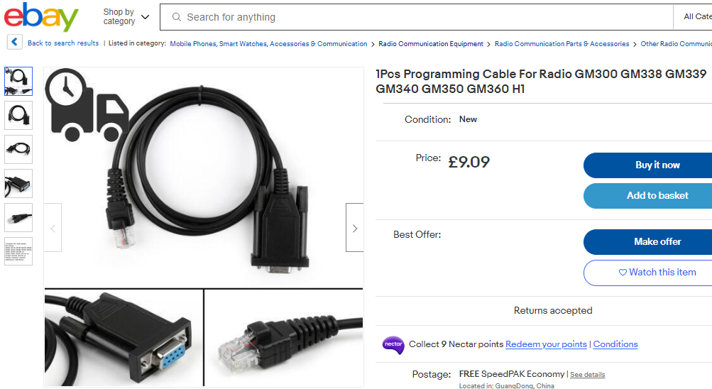
Programming Cables
Mike Gathergood, G4KFK September 2022

Slide 21
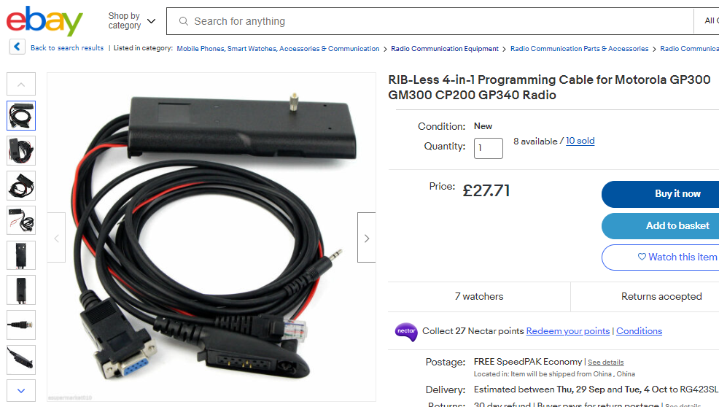
Programming Cables
Mike Gathergood, G4KFK September 2022

