Slide 1
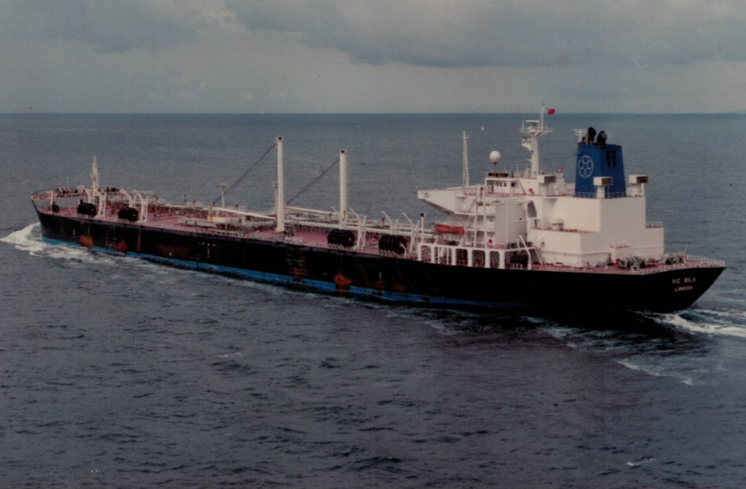
Marine Radio in the 80s
Mike Gathergood, G4KFK September 2022

Slide 2
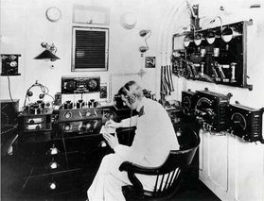
History
“In the existing state of the art, an expert telegraph operator must be carried on every ship. This will, however, be changed within a period of time measurable in months. Wireless telephony working with apparatus of great simplicity will take the place of existing plant; word of mouth will supersede the Morse alphabet; the skilled operator will no longer be required; a ship’s officer after undergoing a very short training will be able to adjust the apparatus, and send and receive messages with much greater ease.”
The author of the above is describing GMDSS, or Global Maritime Distress and Safety System. GMDSS enables non-technical people to communicate from ship to shore, and includes satellite communications, VHF radio with selective calling, emergency beacons and transponders.
Mike Gathergood, G4KFK September 2022

Slide 3
History
“In the existing state of the art, an expert telegraph operator must be carried on every ship. This will, however, be changed within a period of time measurable in months. Wireless telephony working with apparatus of great simplicity will take the place of existing plant; word of mouth will supersede the Morse alphabet; the skilled operator will no longer be required; a ship’s officer after undergoing a very short training will be able to adjust the apparatus, and send and receive messages with much greater ease.”
David Cook, Marconi Company
Letter to the Sir William Preece of the GPO, 1907
Mike Gathergood, G4KFK September 2022

Slide 4
History
“In the existing state of the art, an expert telegraph operator must be carried on every ship. This will, however, be changed within a period of time measurable in months. Wireless telephony working with apparatus of great simplicity will take the place of existing plant; word of mouth will supersede the Morse alphabet; the skilled operator will no longer be required; a ship’s officer after undergoing a very short training will be able to adjust the apparatus, and send and receive messages with much greater ease.”
David Cook, Marconi Company
Letter to the Sir William Preece of the GPO, 1907
The “period of time measurable in months” turned out to be 81 years. The statutory requirement to carry a radio officer ended soon after the introduction of GMDSS in 1988.
Mike Gathergood, G4KFK September 2022

Slide 5
History
Amplitude Modulation – Reginald Fessenden, 1901
Real CW (as opposed to sparks) – Valdemar Poulsson, 1904
Triode Valve – Lee de Forrest, 1906
First ship-to-shore voice transmission, Lee de Forrest, 1907
First electronic oscillator – Lee de Forrest, 1911
Mike Gathergood, G4KFK September 2022

Slide 6
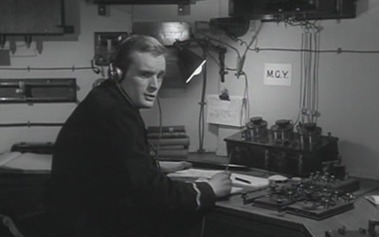
History
Mike Gathergood, G4KFK September 2022

Slide 7
History
Radio communication was first deployed on ships at the turn of the 20th century, at which time the technology was telegraphy-only. There were no statutory equipment or watchkeeping requirements, until the Titanic disaster in 1912.
Mike Gathergood, G4KFK September 2022

Slide 8
History
Radio communication was first deployed on ships at the turn of the 20th century, at which time the technology was telegraphy-only. There were no statutory equipment or watchkeeping requirements, until the Titanic disaster in 1912. This resulted in a number of changes:
Equipment requirements were standardised.
Watchkeeping hours were standardised.
Distress frequencies were standardised.
Regular “silence periods” were introduced.
Numerous technological changes followed, and legislation adapted to those changes:
Radio telephony (voice) and automated telegraphy (teletype).
HF (high frequency) for long distance communications.
VHF/FM for direct bridge-to-bridge communications between deck officers.
However, Morse code remained important until the full implementation of GMDSS in the late 1980s, and this in turn required the role of a “Radio Officer”.
Mike Gathergood, G4KFK September 2022

Slide 9
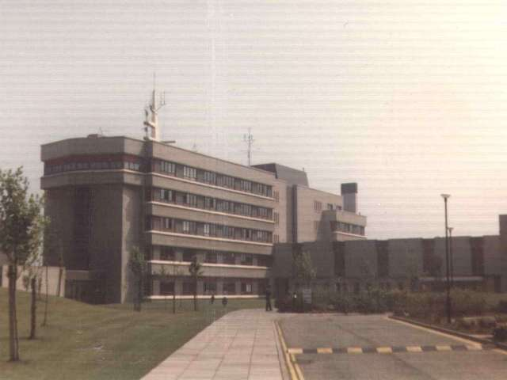
History
In the early 1980s, the qualifications for a sea-going radio operator were the MRGC (Maritime Radiocommunication General Certificate), and the Radar Maintenance Certificate.
There were several colleges in the UK at that time which offered these qualifications, including:
Leith Nautical College (near Edinburgh).
South Shields Marine Tech (near Newcastle).
Fleetwood Nautical College (near Blackpool).
A typical career path involved:
2 years at a nautical college studying for the MRGC.
Up to 6 months at sea as a Junior Radio Officer (serving under a qualified R/O).
4 months at a nautical college studying for the Radar Maintenance Certificate.
Then eligible for service as a Radio Officer.
Mike Gathergood, G4KFK September 2022

Slide 10
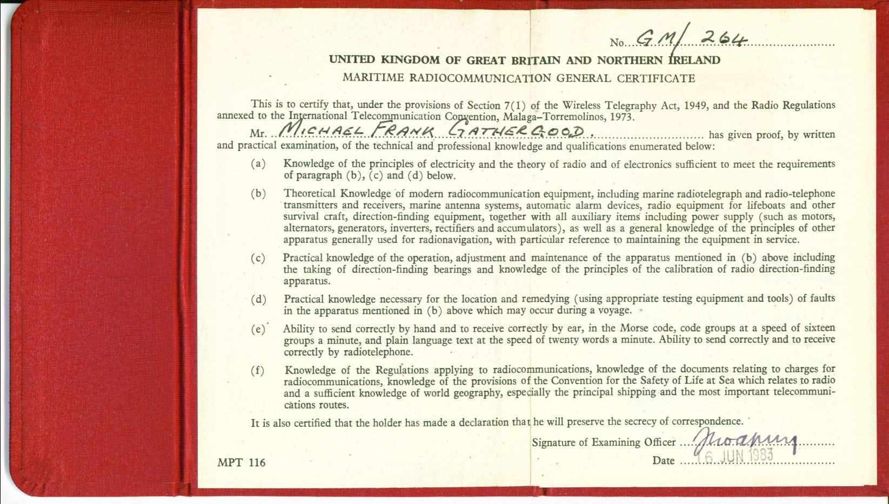
The MRGC
Mike Gathergood, G4KFK September 2022

Slide 11
The MRGC
The MRGC required the following:
Knowledge of the principles of electricity, and theory of radio and electronics.
Knowledge of the workings of radio receivers, radio transmitters, antenna systems, direction finding, and a practical demonstration of fault-finding in such equipment.
Morse code at 20wpm.
Knowledge of applicable regulations, and the SOLAS (safety of life at sea) convention.
Mike Gathergood, G4KFK September 2022

Slide 12
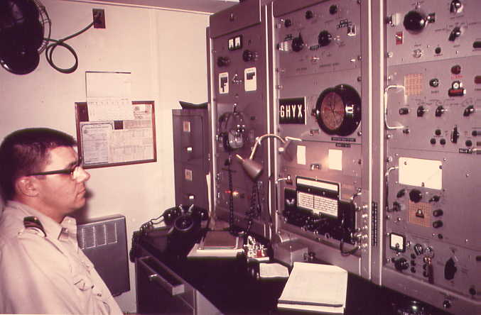
Equipment of the late 70s and early 80s
The ship’s radio equipment of that era typically included:
A main MF/HF transmitter, typically 400W on MF, and >1kW PEP on HF.
A standby MF transmitter, designed to run from the ship’s 24V DC battery supply, typically 100W CW/MCW.
A main MF/HF receiver.
A standby MF/HF receiver, designed to run from the ship’s 24V DC battery.
Automatic alarm receiver on 500kHz.
VHF/FM transceivers (in the radio room and the bridge).
Hand portable UHF/FM transceivers (used by deck crew).
Radioteletype equipment (used a protocol similar to the amateur AMTOR system).
Weather fax receiver (in the bridge).
LORAN and/or satellite navigation receiver (in the bridge).
Lifeboat radio(s).
The standby transmitter included an automatic keying device to send a distress signal on 500kHz.
Mike Gathergood, G4KFK September 2022

Slide 13
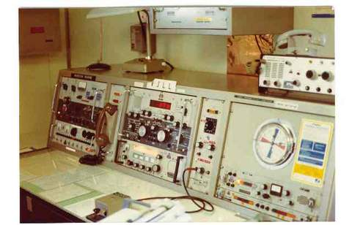
Frequencies
Coastal Telegraphy, now obsolete:
410, 425, 454, 468, 480, 500 and 512kHz. The distress frequency was 500kHz.
Coastal Telephony:
Approximately 1700 – 2300kHz, split frequency half-duplex or full-duplex. Each coast station had at least one primary transmit and receive frequency, as well as several working frequencies.
The distress frequency was (and remains) 2182kHz.
Long distance HF:
4MHz, 6MHz, 8MHz, 12MHz, 16MHz, 18MHz, 22MHz and 25MHz.
8364kHz was (and remains) a distress frequency.
VHF/FM:
156 – 162MHz, 50kHz channel steps.
Most channels are simplex, though some are full duplex with a 4.6MHz offset.
156.800MHz (Channel 16) was, and still is, the calling and distress frequency.
Mike Gathergood, G4KFK September 2022

Slide 14
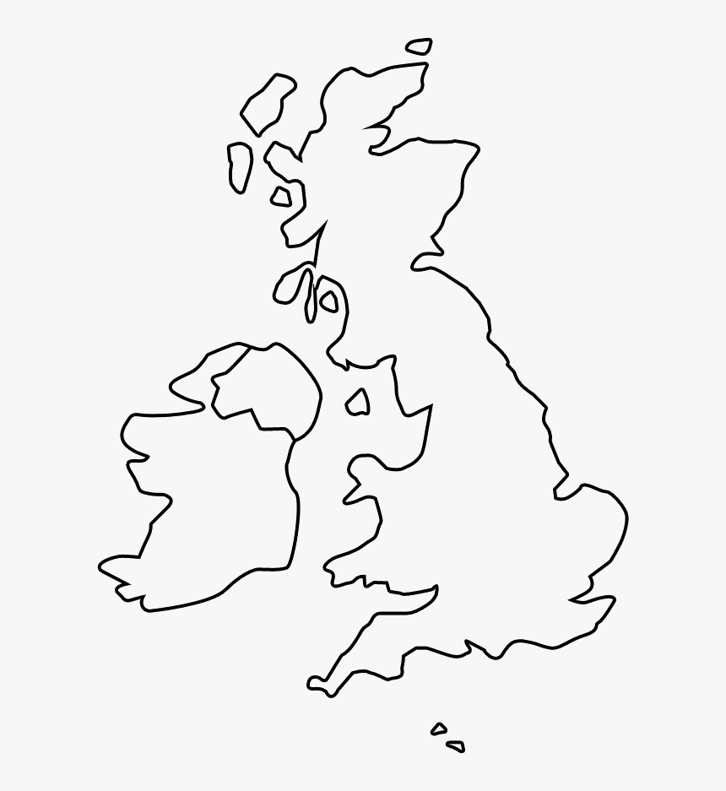
UK Coast Stations ca. 1983
GKR (Wick)
GND (Stonehaven)
GNE (Oban)
GCC (Cullercoats)
GPK (Port Patrick)
GKZ (Humber)
GLV (Anglesey)
GKA (Portishead)
GIL (Ilfracombe)
GNF (North Foreland)
GLD (Land’s End)
GNI (Niton)
Mike Gathergood, G4KFK September 2022

Slide 15
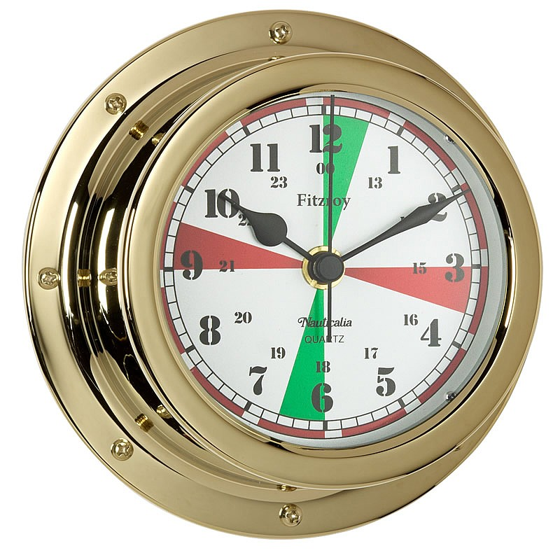
Statutory Watchkeeping & Silence Periods
In the early 80s, when not engaged in operation on other frequencies, the Radio Officer was required to maintain a watch on 500kHz and 2182kHz as follows:
08:00 to 12:00 local time.
A further 4 hours of the Officer’s choice.
Outside these hours, an automated receiver on 500kHz would sound an alarm in the Radio Officer’s cabin, and on the bridge, upon receipt of a distress signal.
Radio silence was required as follows:
On 500kHz, from 15 to 18, and from 45 to 48 minutes past the hour.
On 2182kHz, from 00 to 03, and from 30 to 33 minutes past the hour.
Transgressors could expect to hear a barrage of “QRT SP” in response.
Ship’s radio room clocks had the silence periods displayed, normally green for 2182kHz and red for 500kHz. Additional red markers showed the 4 seconds on, 1 second off, long dashes which preceded an SOS call – it was this signal which triggered the auto-alarm receiver.
Mike Gathergood, G4KFK September 2022

Slide 16
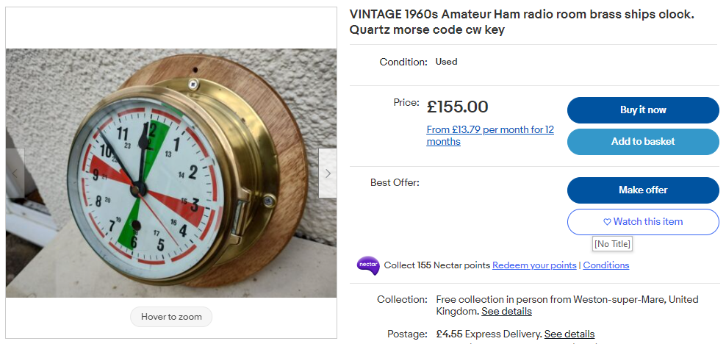
Statutory Watchkeeping & Silence Periods
Mike Gathergood, G4KFK September 2022

Slide 17
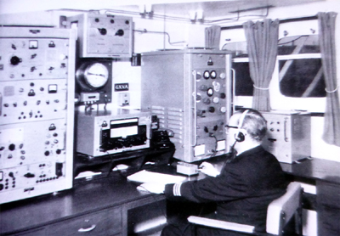
Transit Reports
Transit reports were sent regularly, and included the following details:
Date and time
Ship name and callsign
Depart from (port) date and time
Estimated arrival at (port) date and time
Mike Gathergood, G4KFK September 2022

Slide 18
Transit Reports
Transit reports were sent regularly, and included the following details:
Date and time
Ship name and callsign
Depart from (port) date and time
Estimated arrival at (port) date and time
Transit reports have been superseded by an automated system AIS (automatic identification system) which sends packets of data on 161.975 or 162.025MHz. The data includes the ship’s identification, position, course and speed.
Mike Gathergood, G4KFK September 2022

Slide 19
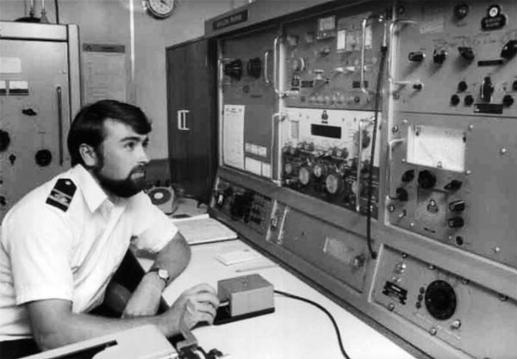
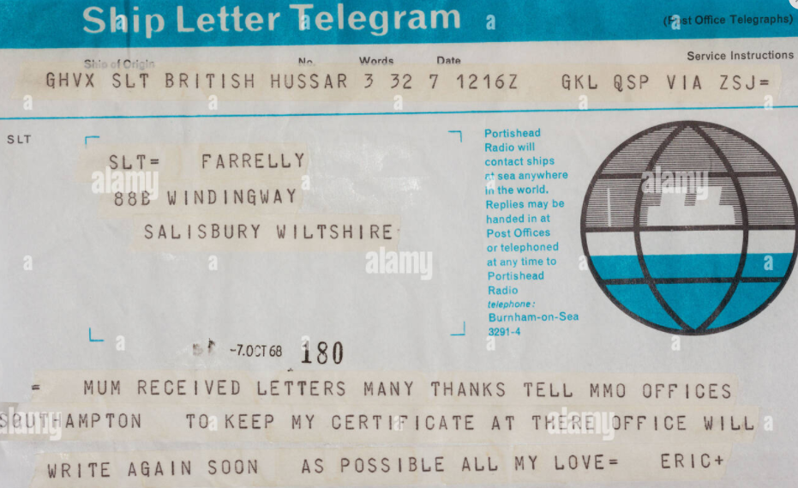
Ships Letter Telegram
Although satellite phones (using the MARECS satellites) were starting to appear by the early 80s, the call costs of $6 per minute meant that the Ships Letter Telegram was the most cost-effective means for crew to keep in touch with friends and family. Sent using CW to a coast station, and then onwards to the recipient as a telegram.
Mike Gathergood, G4KFK September 2022

Slide 20
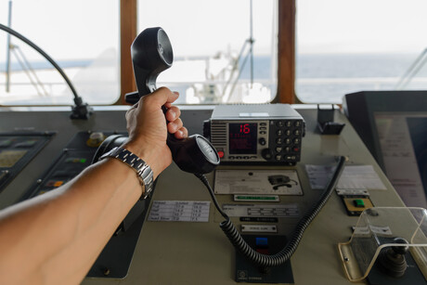
Phone Calls
A number of the VHF Marine Channels had (and still have) a 4.6MHz split between transmit and receive frequencies, allowing full-duplex phone calls for suitably equipped vessels. The coast station transmitted on the higher frequency of the duplex pair, and the ship on the lower frequency; this means that duplex is only possible between a ship and a coast station, not between two ships.
There were also duplex pairs of HF channels (4MHz, 6MHz, 8MHz, 12MHz, 16MHz, 18MHz, 22MHz and 25MHz) for telephone calls. Although these pairs still exist in theory, no coast stations remain with duplex phone capabilities, as satellite communication has superseded HF for such purposes.
Mike Gathergood, G4KFK September 2022

Slide 21
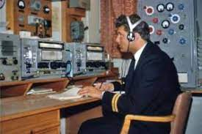
OBS
One of the Deck Officer’s responsibilities was to take weather observations at regular intervals, and to encode those observations (along with the ship’s identification and position) into a telegram comprising groups of five digits.
These OBS telegrams were then given to the Radio Officer, to be sent to the closest coastal station (usually on MF telegraphy) from where they were distributed to the worldwide meteorological community – including the UK’s Met Office in Bracknell.
Mike Gathergood, G4KFK September 2022

Slide 22
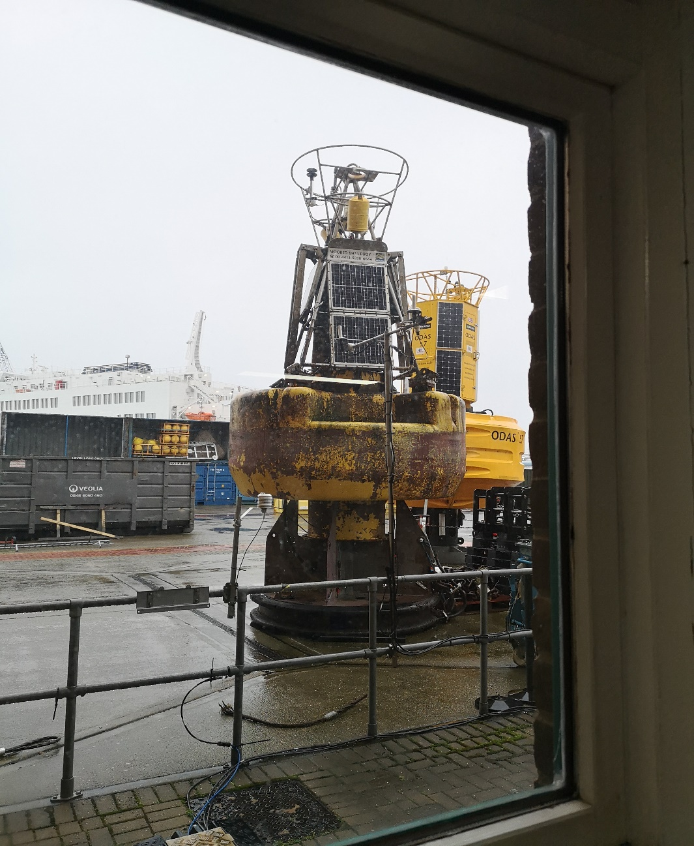
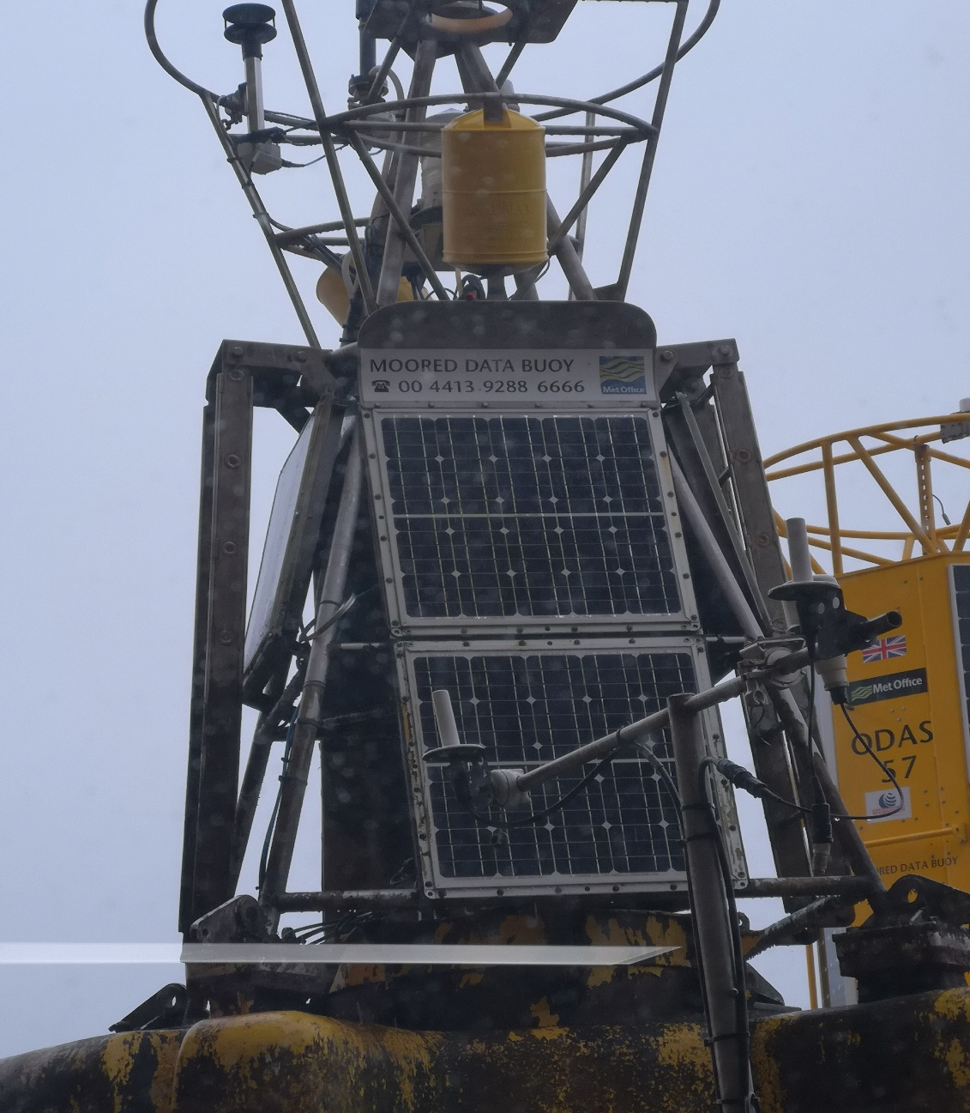
OBS has been superseded by these…
National Oceanographic Centre, Southampton, March 2020
Mike Gathergood, G4KFK September 2022

Slide 23
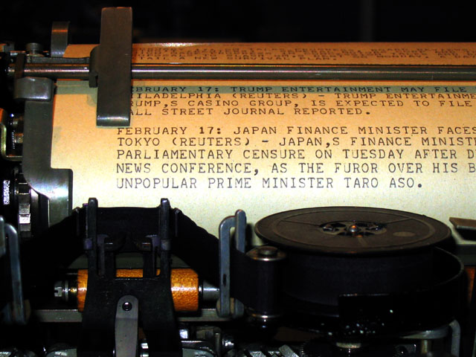
SITOR Teletype
SITOR (Simplex Teletype over Radio) was a commercial error-corrected teletype standard which was adopted in the 70s. It was very similar in operation to the amateur standard AMTOR, and relied on each character being encoded as a combination of four “1”s and three “0s”, instead of the 5-bit code used by conventional teletype. A single bit error could therefore be detected, and a repeat requested automatically by the receiving equipment.
The system became obsolete in the late 80s, as satellite-based voice and teletype systems became economically viable.
Mike Gathergood, G4KFK September 2022

Slide 24
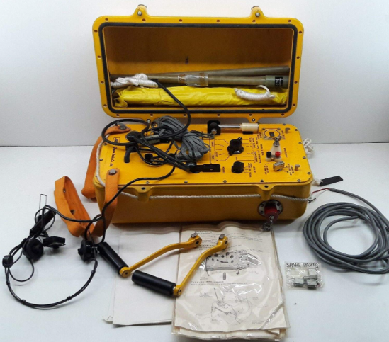
The Lifeboat Radio(s)
Ships were required to carry one or more lifeboat radio, and it was the Radio Officer’s responsibility to test it weekly.
The lifeboat radio was a sealed watertight unit, allegedly buoyant (I never tested that claim), and included a man-powered generator with crank handles and/or pedals, an AM transmitter/receiver on 2182kHz, and an MCW (modulated CW) transmitter/receiver on 500kHz. Some also had 8364kHz fitted. They had an integral ATU to match into a whip and/or wire antenna that was stowed in the watertight case, and an automatic keying device for a distress signal on 500kHz.
Some ships also carried an EPIRB (Emergency Position Indicating Radio Beacon), which operated on the aviation distress frequency, 121.5MHz.
Mike Gathergood, G4KFK September 2022

Slide 25
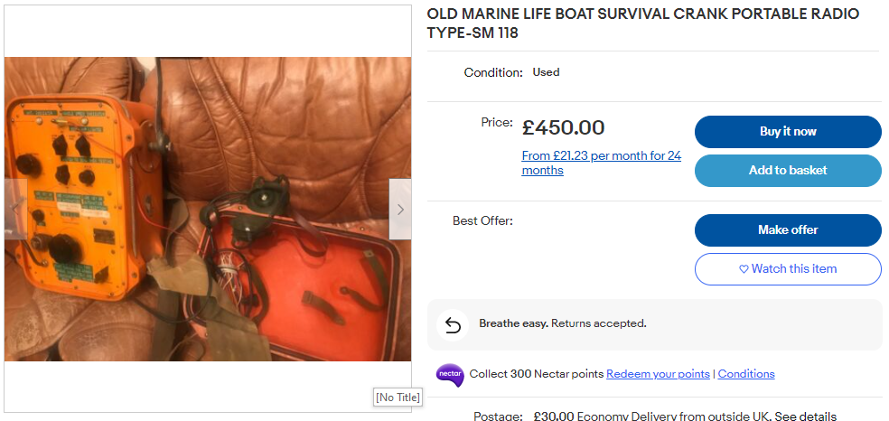
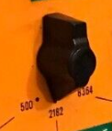
The Lifeboat Radio(s)
Mike Gathergood, G4KFK September 2022

Slide 26
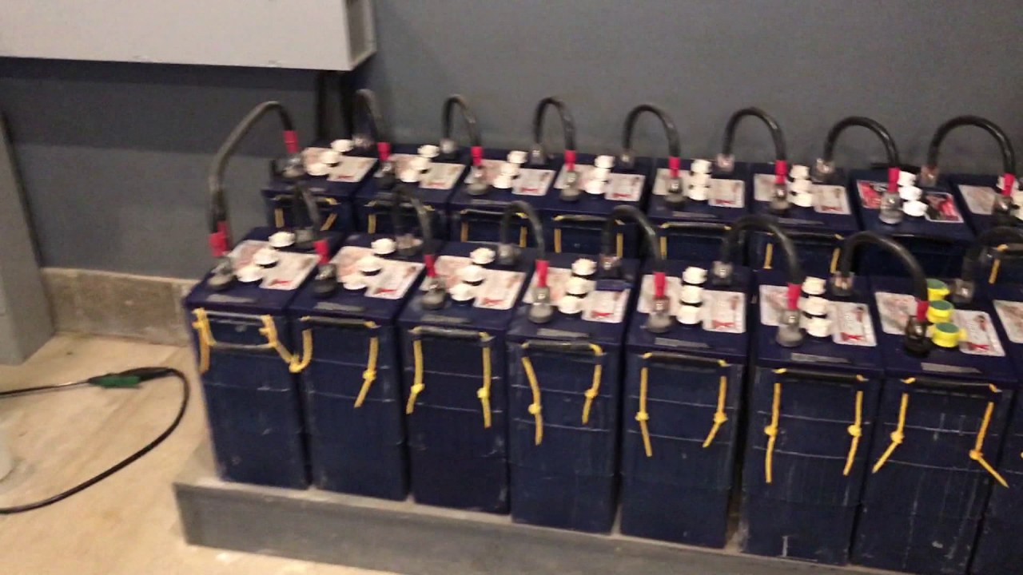
Batteries
Ships were normally equipped with lead acid batteries to maintain essential services in the event of generator failure.
It was the radio officer’s duty to check these regularly, for both electrolyte levels and specific gravity.
Mike Gathergood, G4KFK September 2022

Slide 27
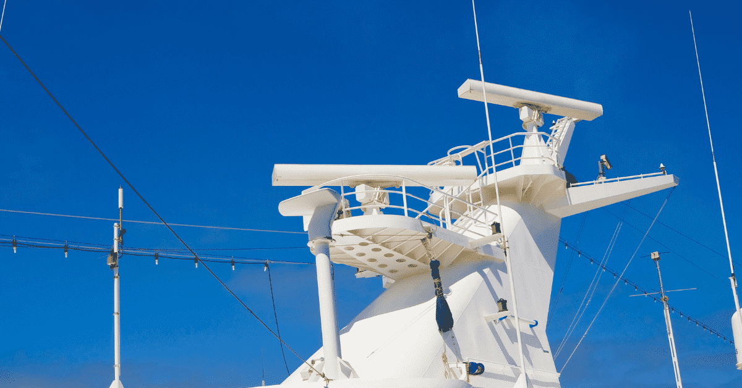
Radar
S band (3GHz) and X band (10GHz) radar were widely used.
The radio officer was responsible for maintenance, which sometimes involved climbing to the monkey island in the most appalling weather to replace the belt driving the antenna.
The radar receivers used crystal diodes, which were unreliable and required frequent replacement.
Mike Gathergood, G4KFK September 2022

Slide 28
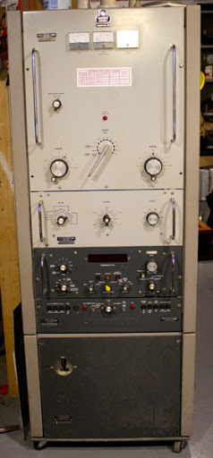
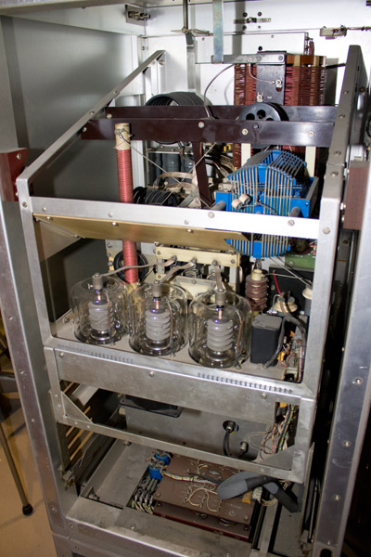
Main Transmitter – Marconi Conqueror
Aerial Current
Anode Voltage
Anode Current
Aerial
Band
Anode
Synthesised Exciter
All transistor
Digital frequency display
Mike Gathergood, G4KFK September 2022

Slide 29
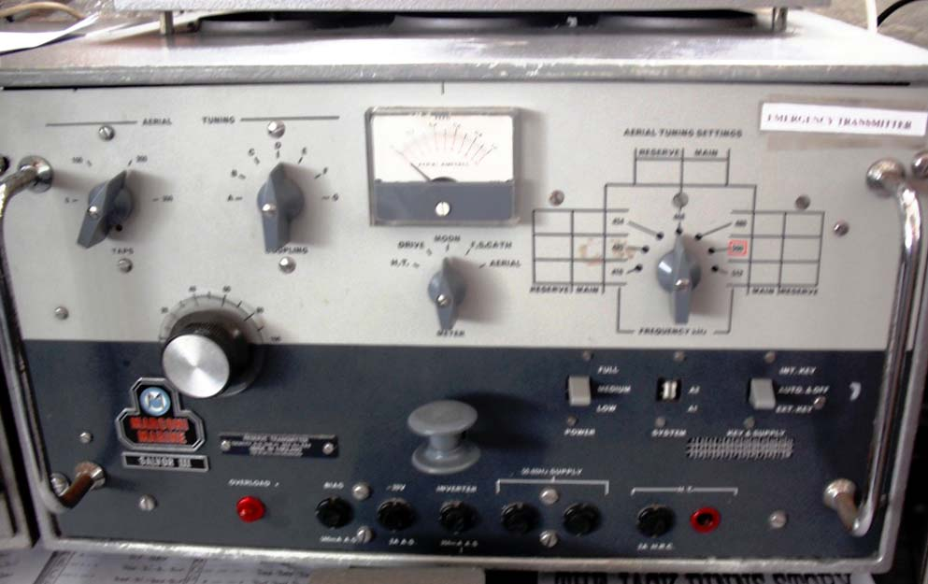
Standby Transmitter – Marconi Salvor III
Mike Gathergood, G4KFK September 2022

Slide 30
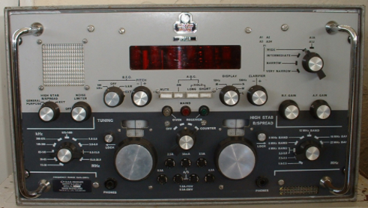
Main Receiver – Apollo
Mike Gathergood, G4KFK September 2022

Slide 31
Lifeboat Radio
Mike Gathergood, G4KFK September 2022

Slide 32
Non Radio Duties
Tuning the TVs in the officers’ and crew’s lounges to local TV channels, when available.*
Scheduling video and/or 16mm movies when local TV not available.
Posting football results every Saturday in the lounges.
Mending anything electronic belonging to crew members.
* The MV Vic Bilh was equipped with three multi-standard VHF/UHF TVs, one in each lounge, and another in the Captain’s quarters. As I recall, they worked well in coastal waters almost everywhere except France. The French analogue TV system was a bit strange.
Mike Gathergood, G4KFK September 2022

Slide 33
MV Vic Bilh, callsign GCHZ, 1983
Mike Gathergood, G4KFK September 2022

Slide 34
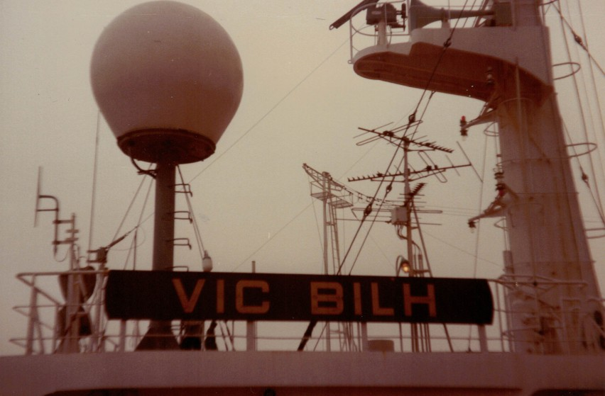
MV Vic Bilh, callsign GCHZ, 1983
MARECS SATCOM
MAIN HF TX
ANTENNA
VHF/FM TX/RX
156-162MHz
Mike Gathergood, G4KFK September 2022

Slide 35
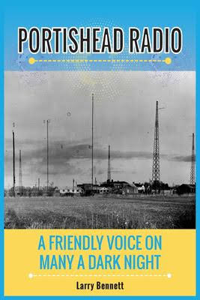
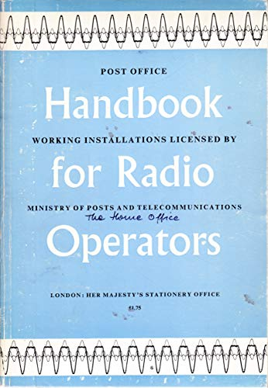
Further Reading…
Available from Amazon, £9.99
Out of print for many years, second-hand copies occasionally seen on eBay.
Mike Gathergood, G4KFK September 2022

