Slide 1
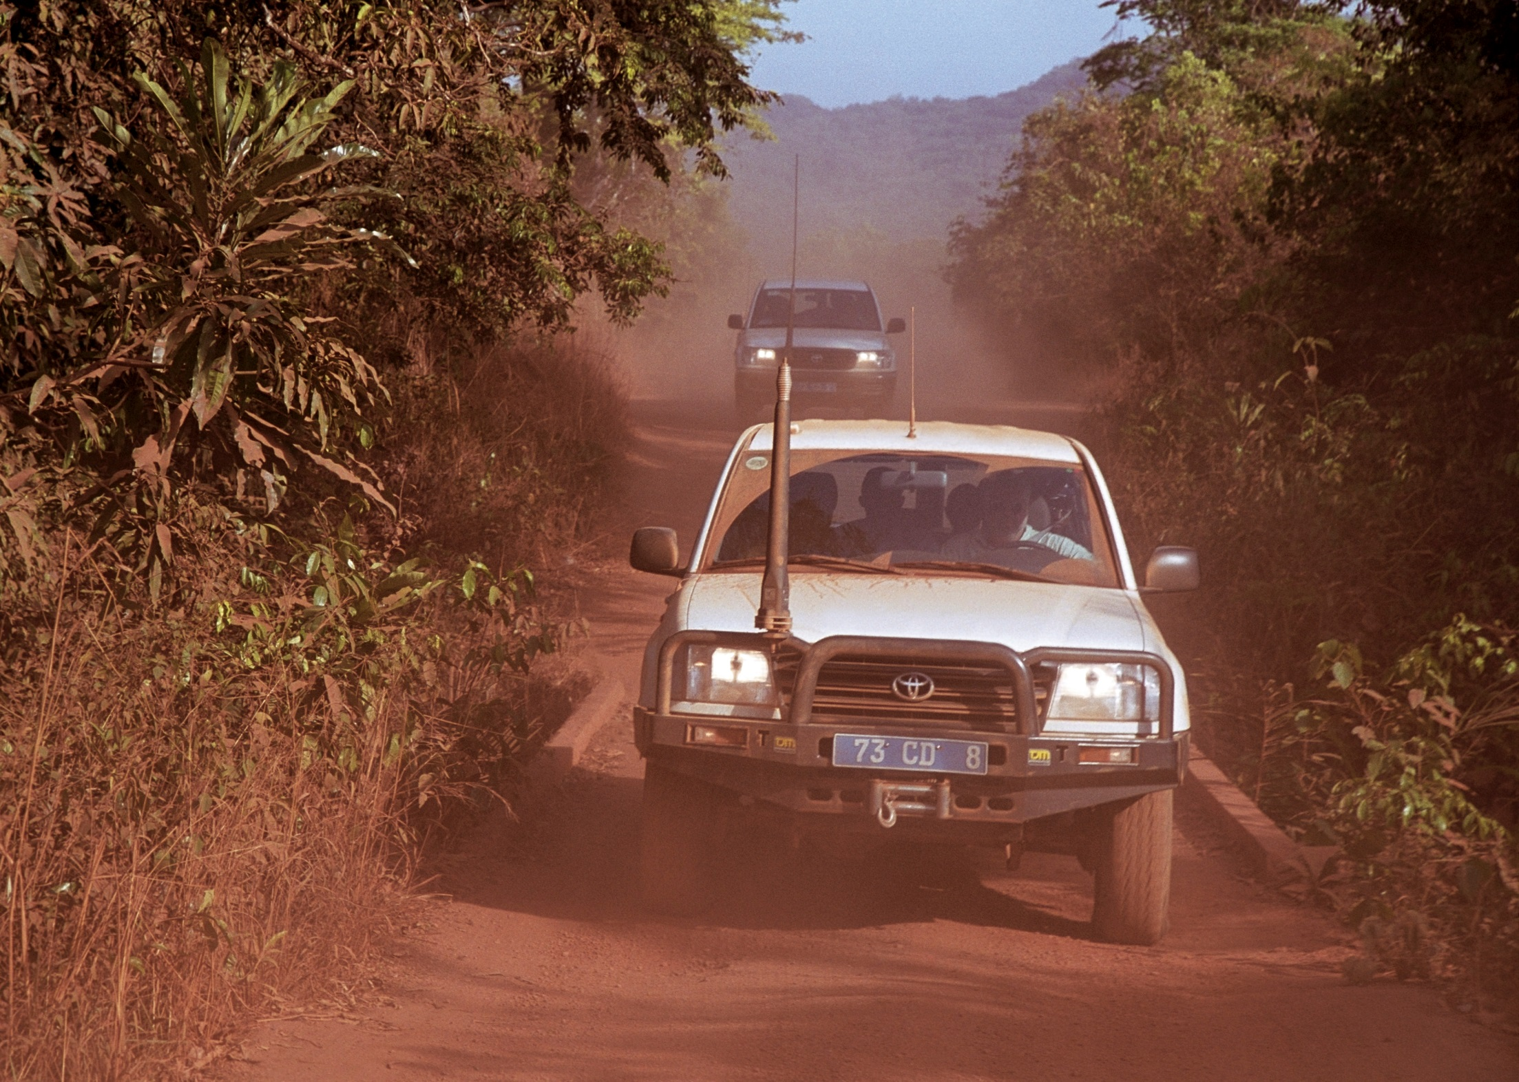
Non-Amateur Use of HF Radio
Mike Gathergood, G4KFK May 2015

Slide 2
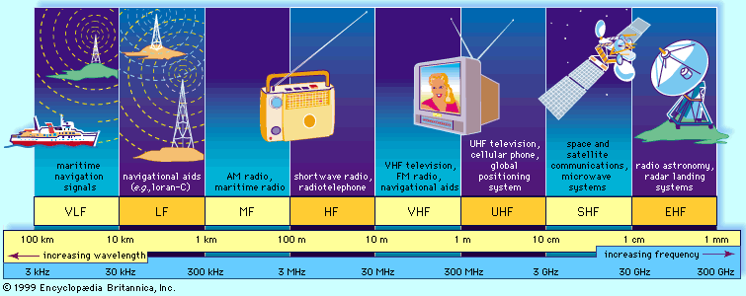
What is “HF Radio”?
For the purpose of this discussion, HF (High Frequency), refers to that part of the spectrum between 1.6MHz and 30MHz.
Mike Gathergood, G4KFK May 2015

Slide 3
Why is HF Radio Relevant in the 21st Century?
In the developed world, we are fortunate to have access to a wide range of reliable, easy-to-use radio services. These include:
VHF and UHF analogue radio, conventional or trunked systems
VHF and UHF digital radio, TETRA, P25, DMR, DPMR
Mobile phone technology (GPRS, 3G, LTE etc…)
Radio users in developing countries are less fortunate:
Costs of providing nationwide VHF/UHF infrastructure can be prohibitive
Providing coverage can be impractical (security, power, network backbone, etc…)
Even where there is coverage, the infrastructure tends to be more fragile than it is in developed countries
HF to the rescue:
Nationwide coverage
No infrastructure required
Resilient
Reliable
Versatile
Mike Gathergood, G4KFK May 2015

Slide 4
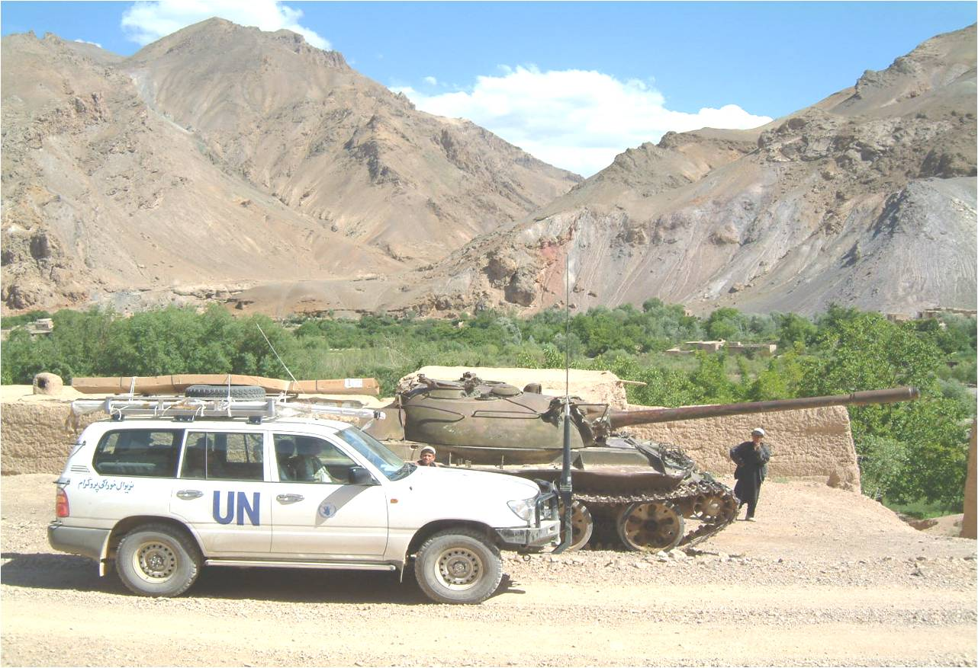
HF Users: UN Peacekeeping Operations
Mike Gathergood, G4KFK May 2015

Slide 5
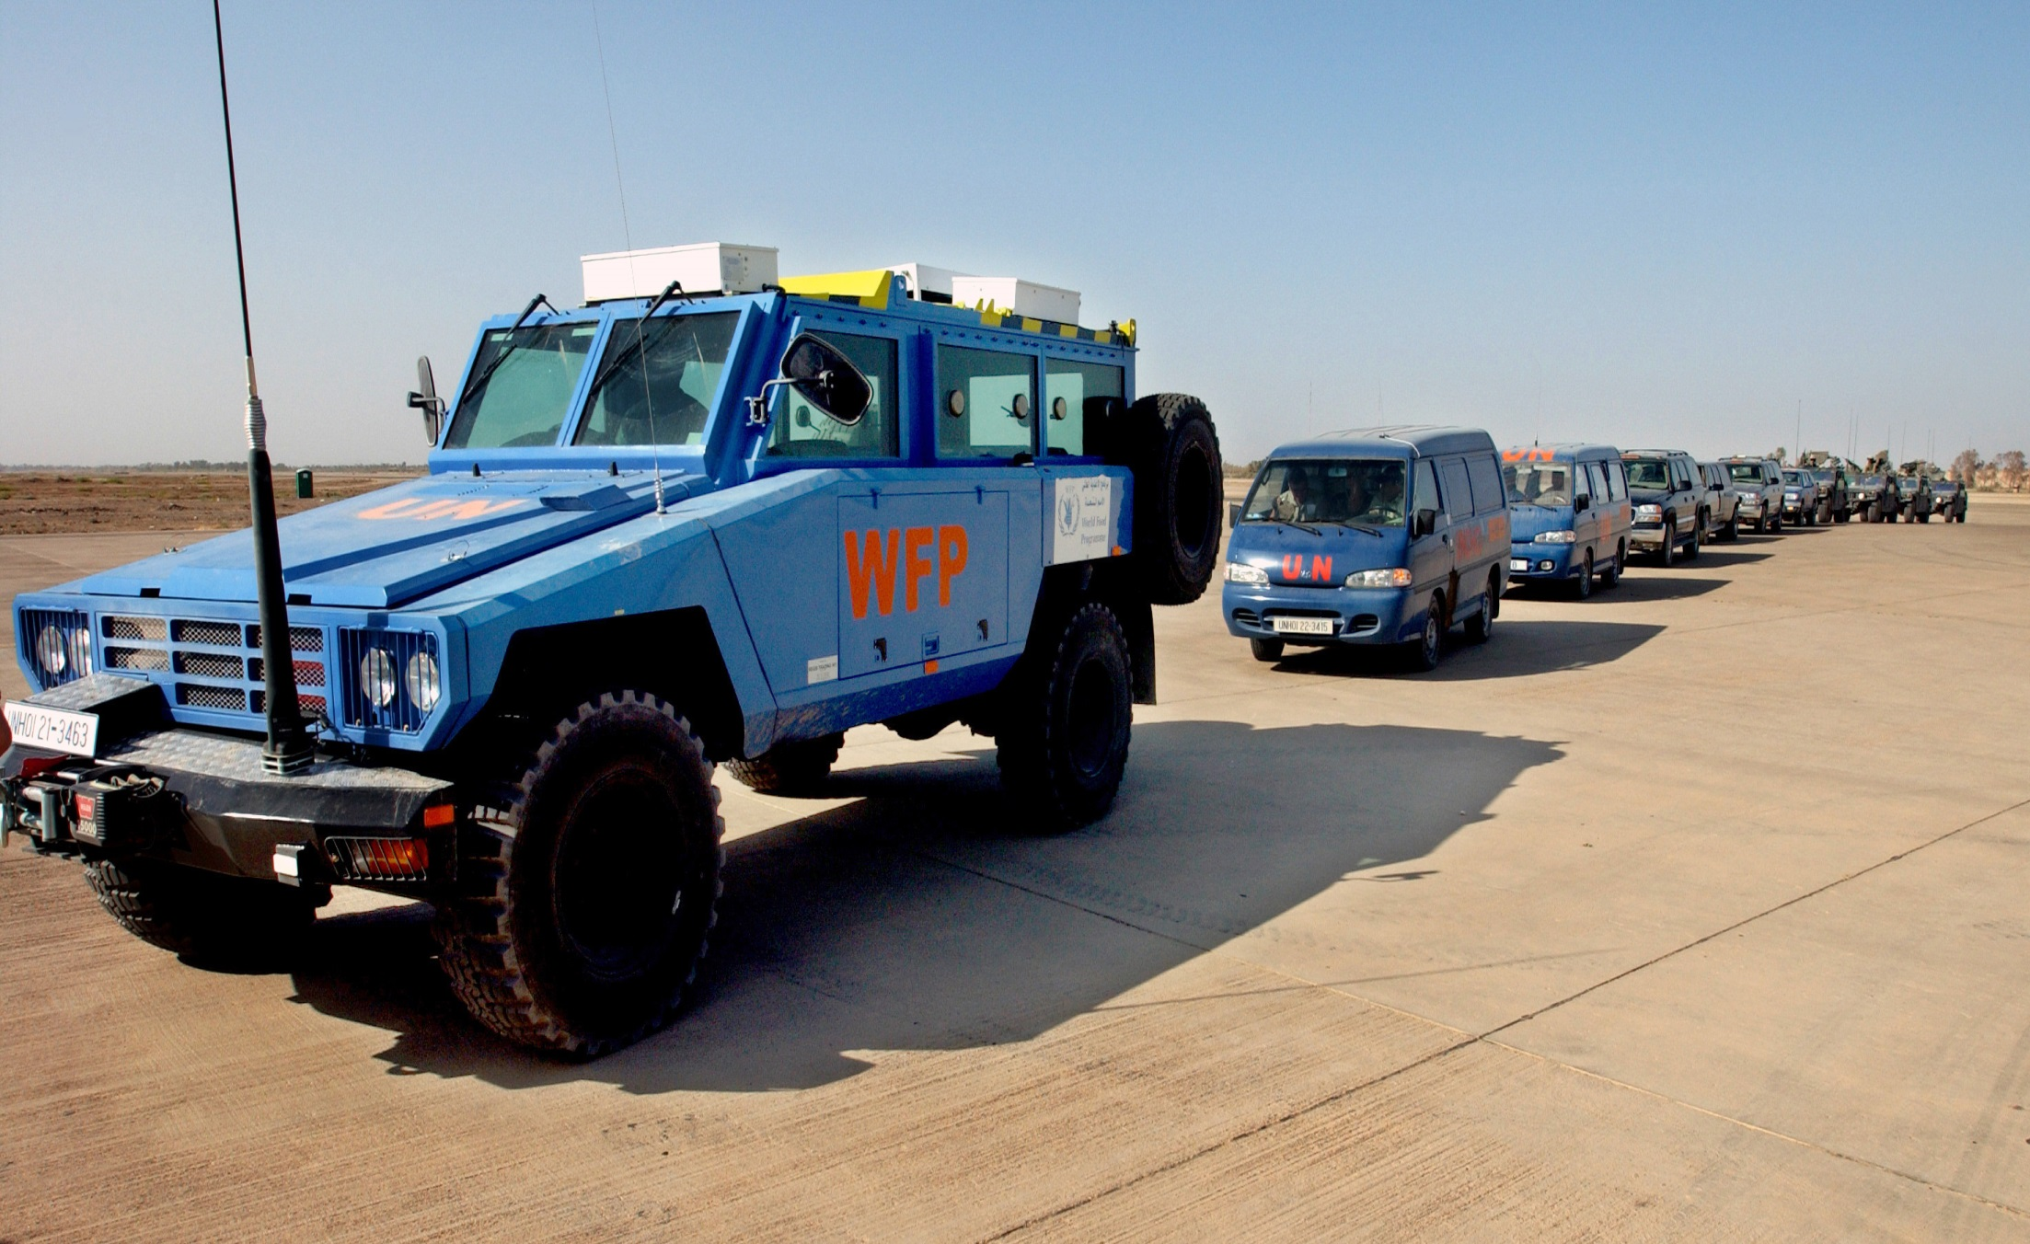
HF Users: UN Humanitarian and Other NGOs
Mike Gathergood, G4KFK May 2015

Slide 6
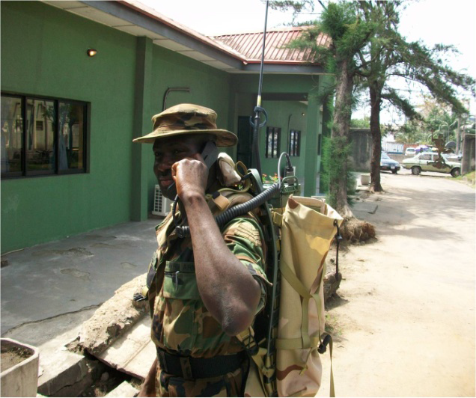
HF Users: Military
Mike Gathergood, G4KFK May 2015

Slide 7
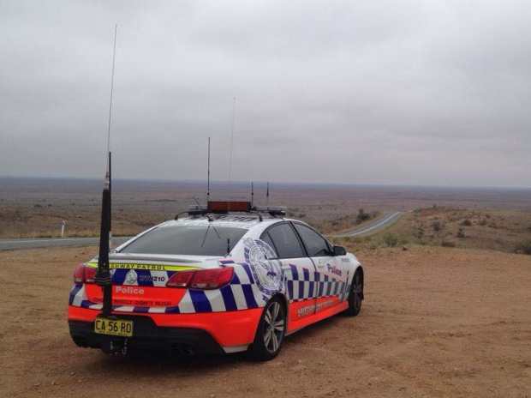
HF Users: Police
Mike Gathergood, G4KFK May 2015

Slide 8
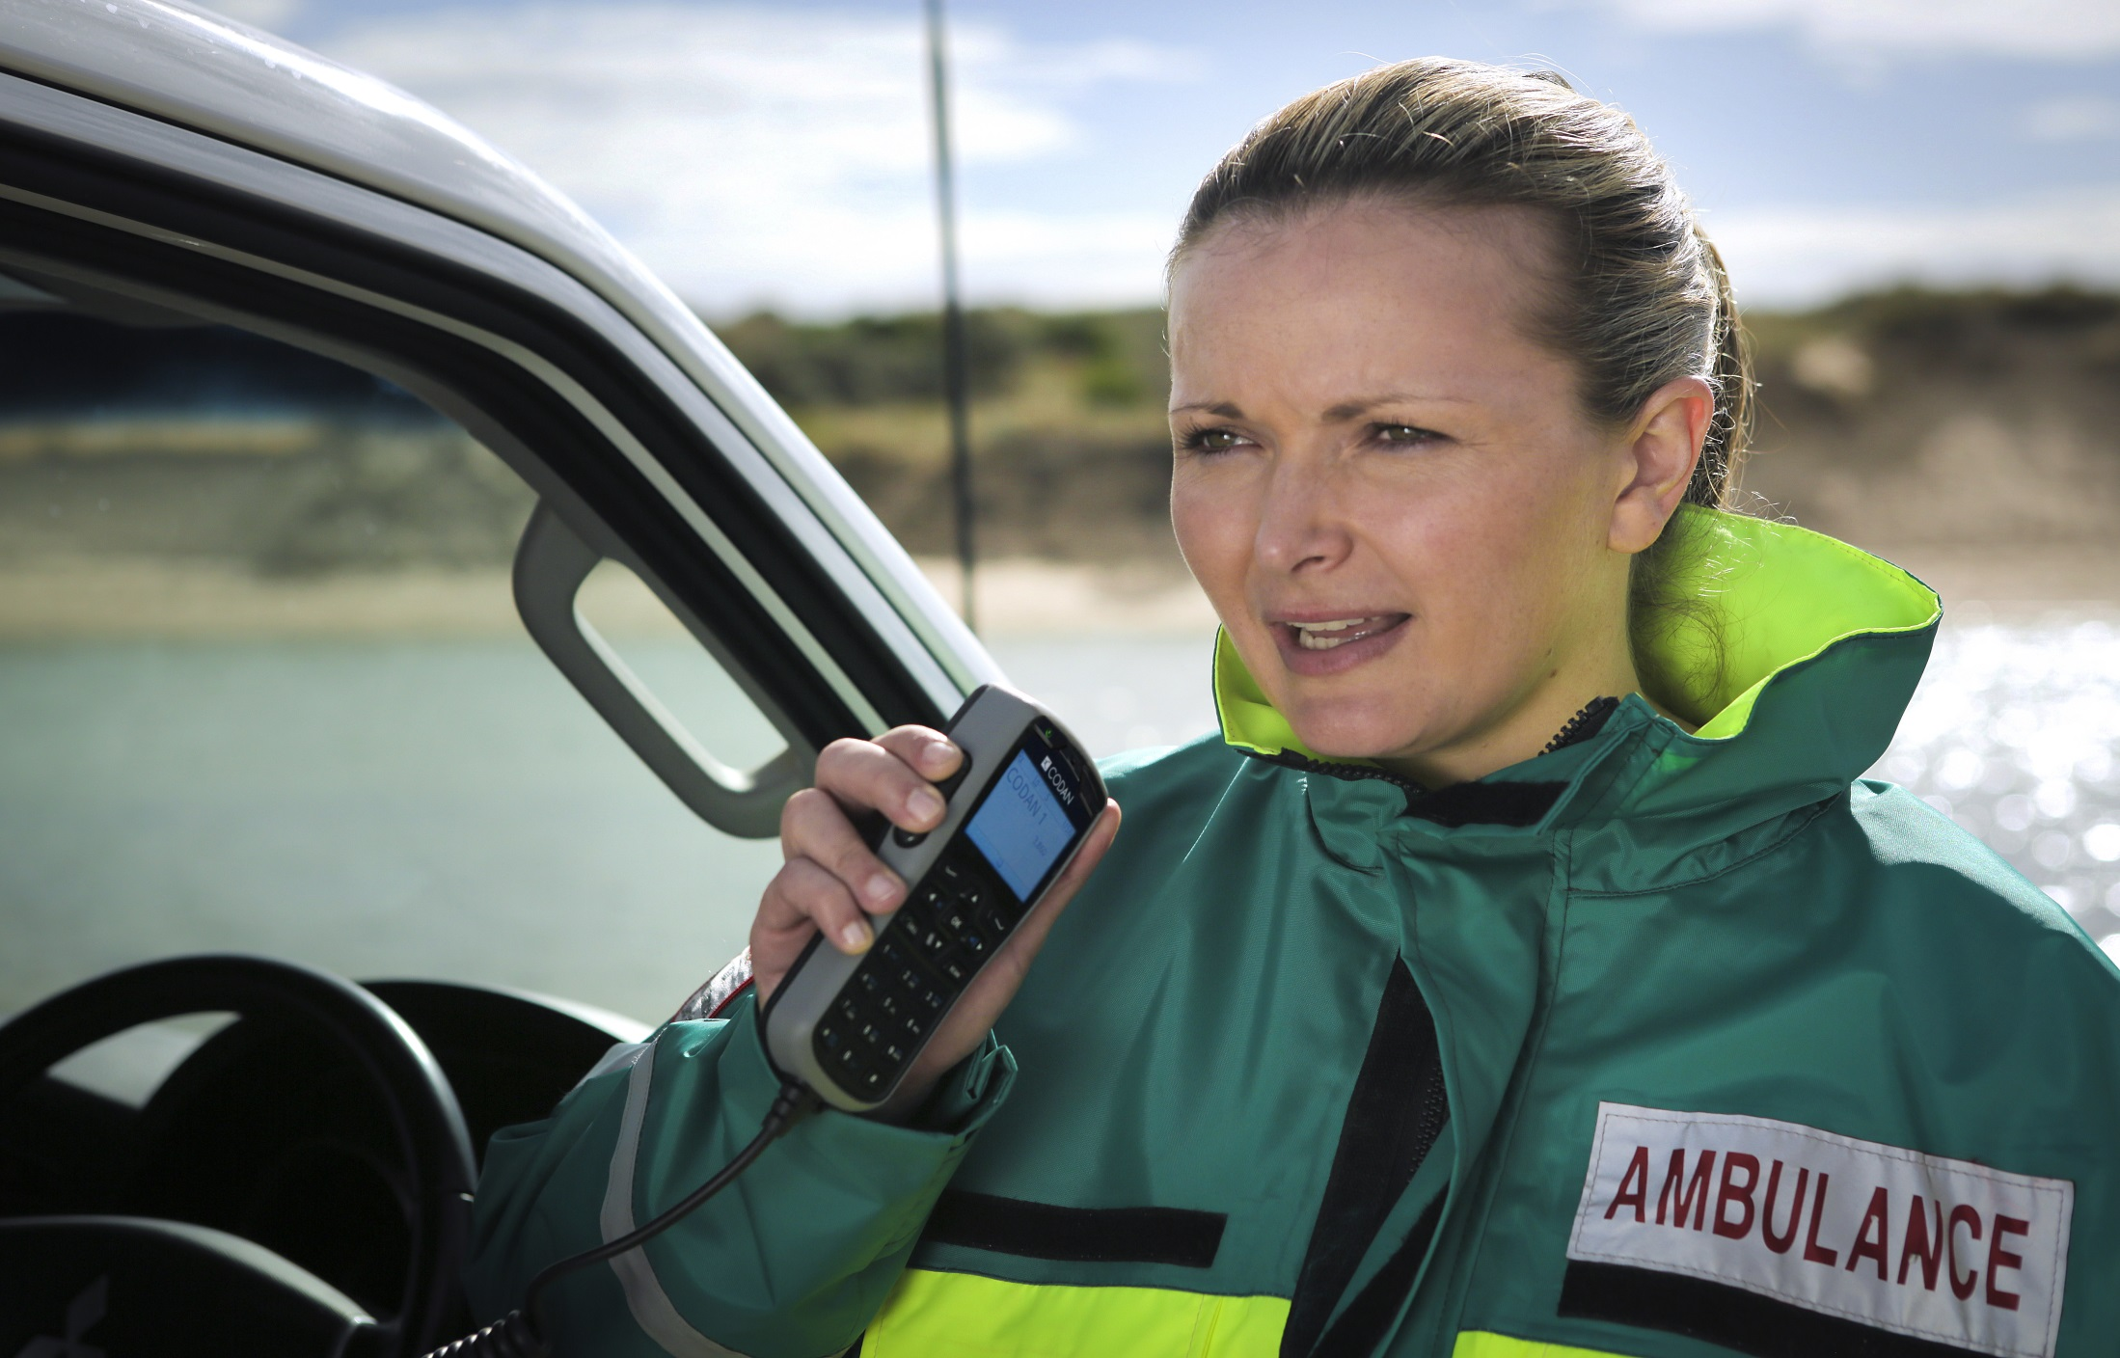
HF Users: Other “Blue Light” Services
Mike Gathergood, G4KFK May 2015

Slide 9

HF Users: Border Security, Customs & Excise
Mike Gathergood, G4KFK May 2015

Slide 10

HF Users: Oil & Gas Exploration, Mining
Mike Gathergood, G4KFK May 2015

Slide 11
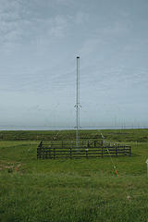
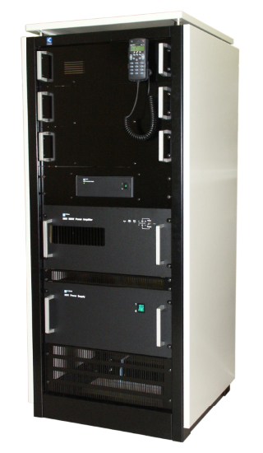
HF Users: Marine Coast Station (1kW)
Mike Gathergood, G4KFK May 2015

Slide 12
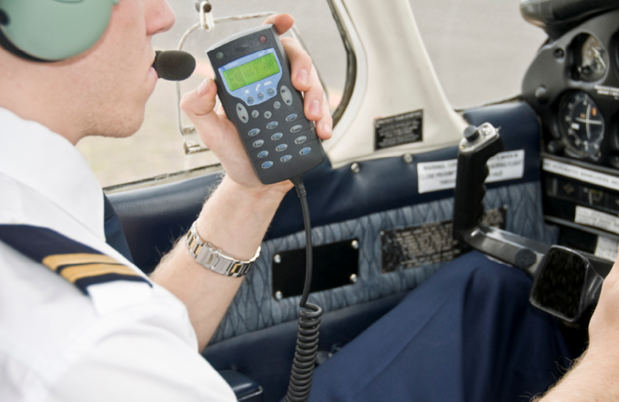
HF Users: Aviation
Mike Gathergood, G4KFK May 2015

Slide 13
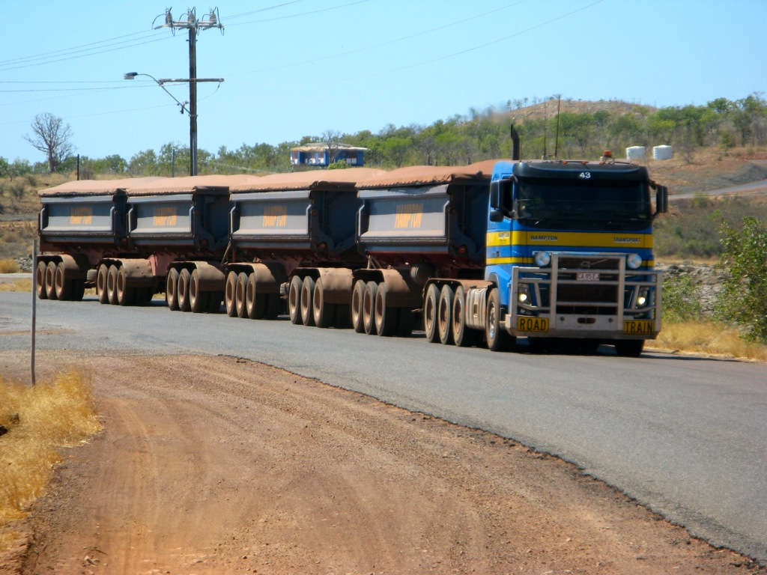
HF Users: Transport
Mike Gathergood, G4KFK May 2015

Slide 14
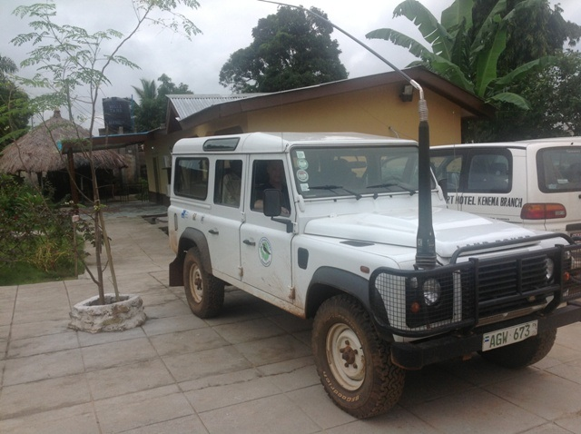
HF Users: National Parks
Mike Gathergood, G4KFK May 2015

Slide 15
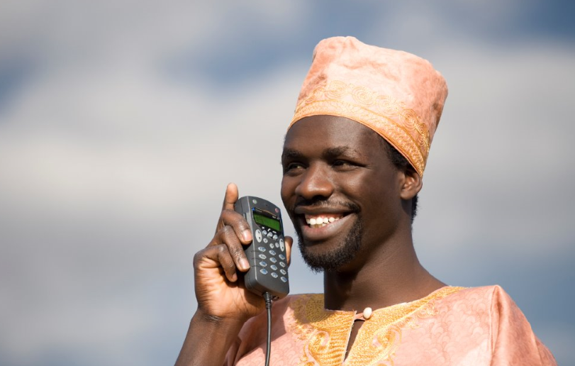
HF Applications: Voice
Mike Gathergood, G4KFK May 2015

Slide 16
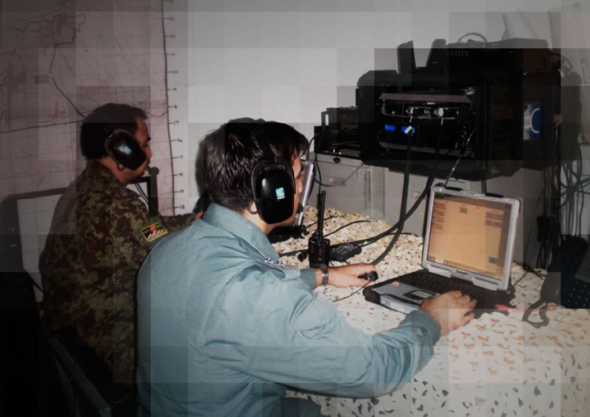
HF Applications: Data (9.6 kbps SSB, 19.2 ISB)
Mike Gathergood, G4KFK May 2015

Slide 17
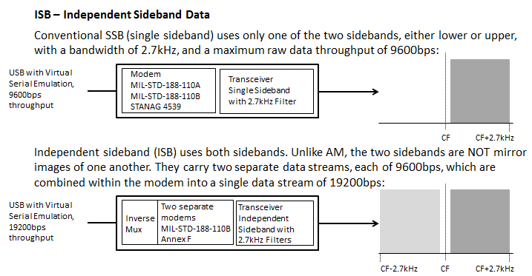
HF Applications: ISB for High Speed Data
Mike Gathergood, G4KFK May 2015

Slide 18
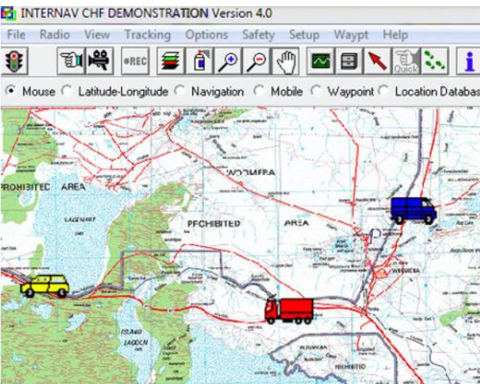
HF Applications: Vehicle Tracking
Mike Gathergood, G4KFK May 2015

Slide 19
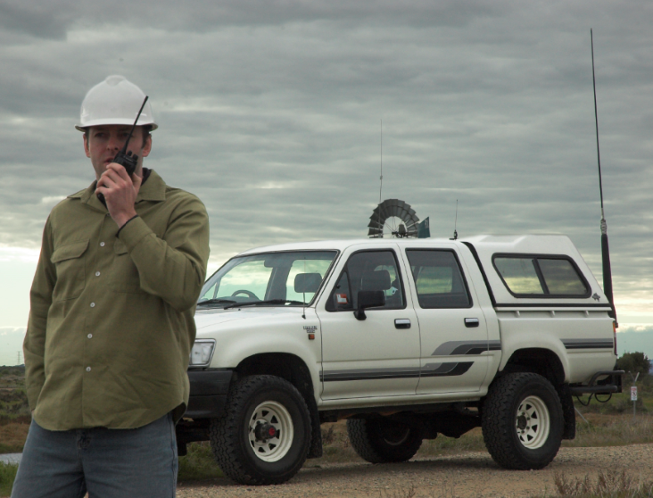
HF Applications: Interconnection HF - VHF/UHF
Mike Gathergood, G4KFK May 2015

Slide 20
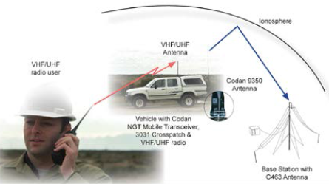
HF Applications: Interconnection HF - VHF/UHF
Mike Gathergood, G4KFK May 2015

Slide 21

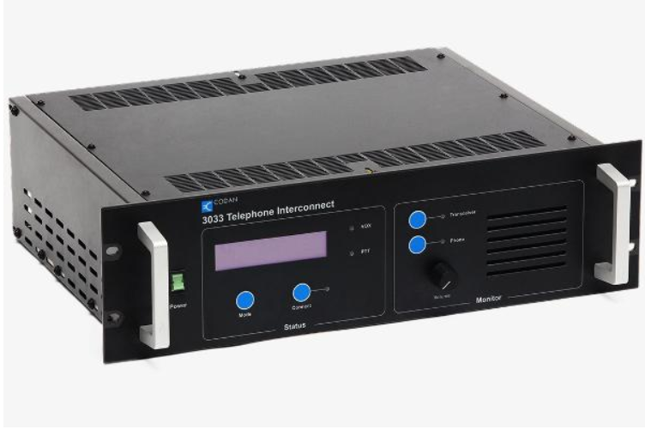
HF Applications: Interconnection HF - Phone
Mike Gathergood, G4KFK May 2015

Slide 22
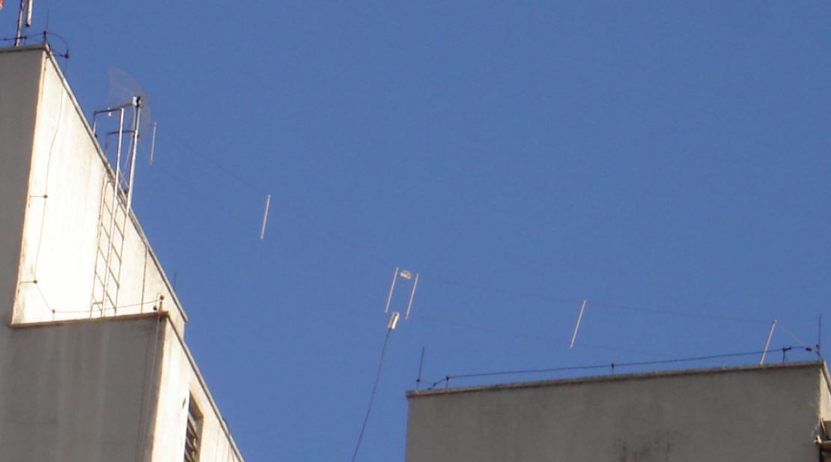
Antennas: Base Station – Broadband Dipole
Mike Gathergood, G4KFK May 2015

Slide 23
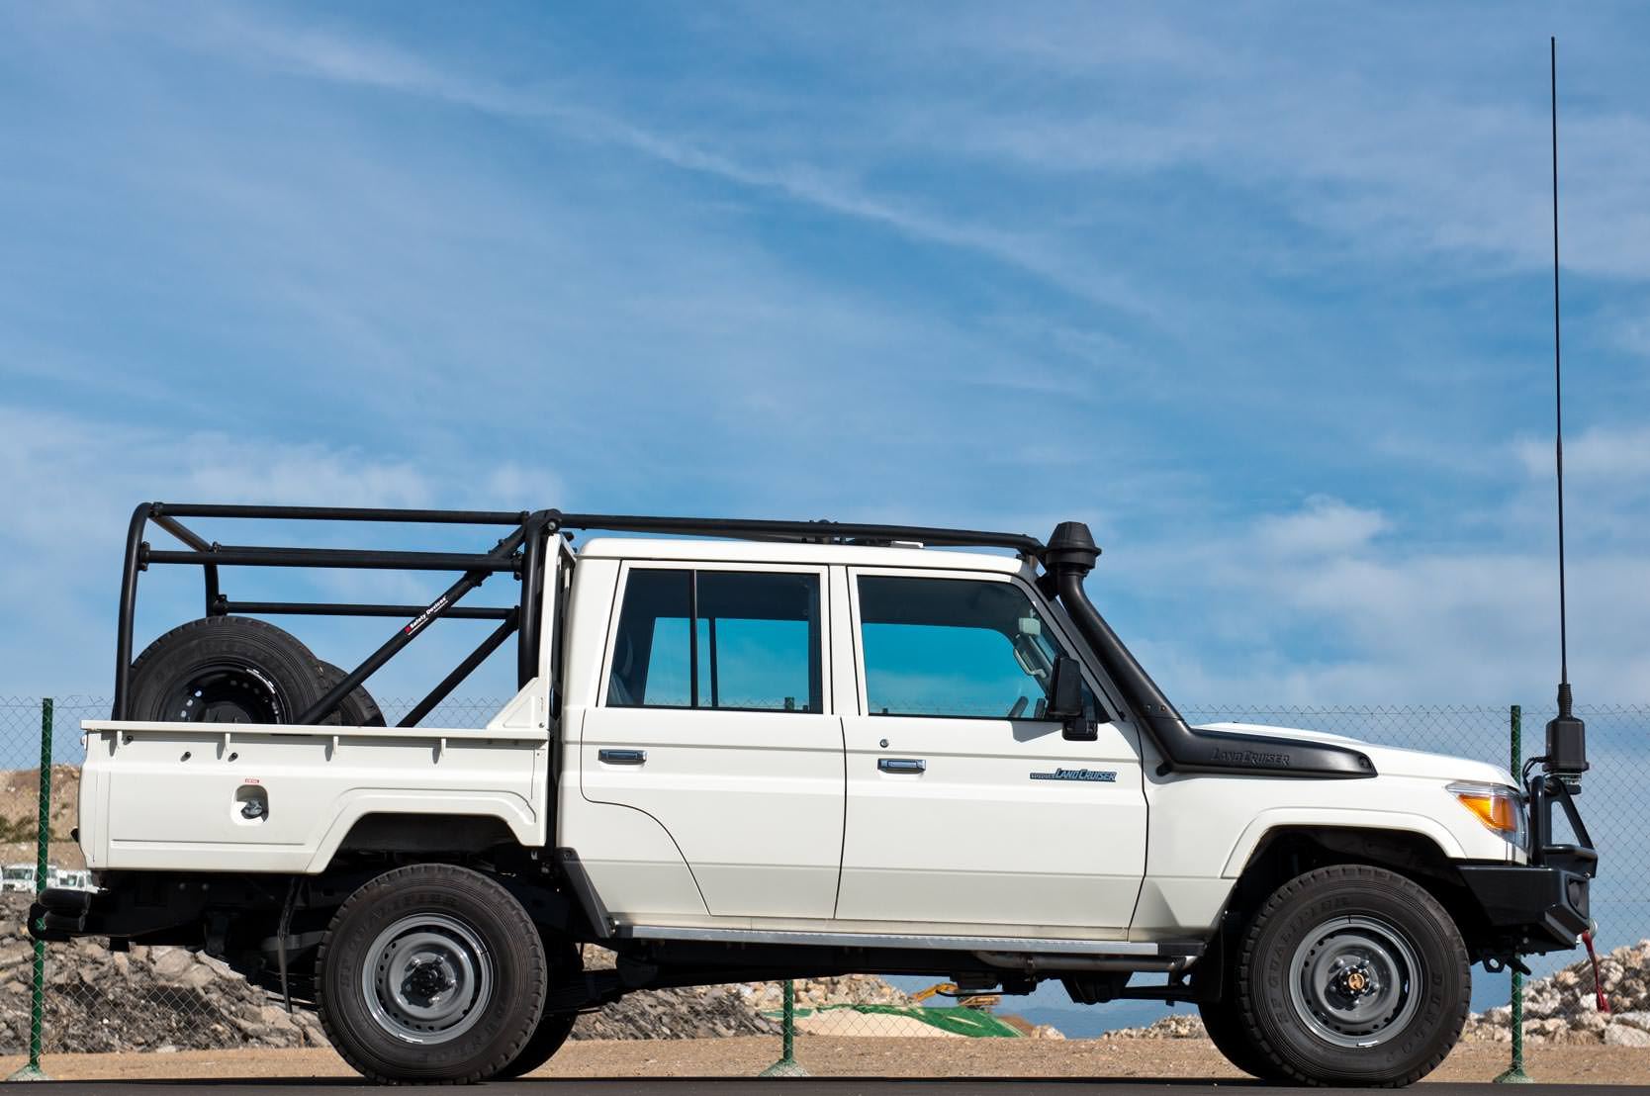
Antennas: Mobile – Autotuning Whip
Mike Gathergood, G4KFK May 2015

Slide 24
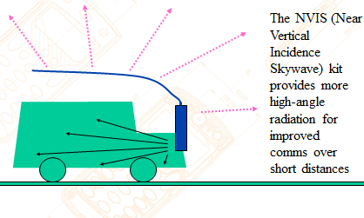
Antennas: Mobile – NVIS
Mike Gathergood, G4KFK May 2015

Slide 25
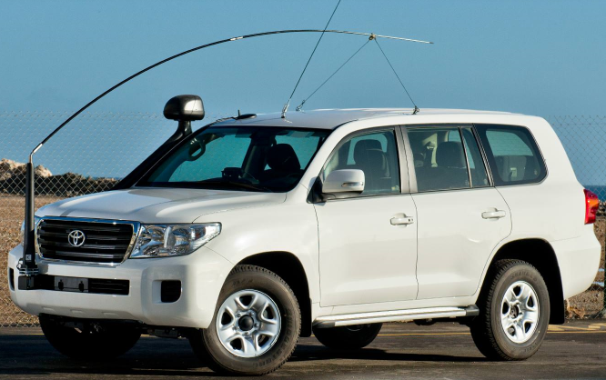
Antennas: Mobile – NVIS
Mike Gathergood, G4KFK May 2015

Slide 26
Voice Calling
User “A” picks up microphone and calls user “B”
Downsides:
User “B” must be monitoring the radio. Limits his ability to do anything else
Users “A” and “B” must be on the same channel. HF radio generally needs at least 3 frequencies in order to provides 24/7 coverage over any given path. Need to agree in advance to monitor each available channel at certain times of day
No end-to-end acknowledgement. If user “B” does not answer, user “A” has no idea why:
  No propagation?
  User “B” has equipment fault?
  User “B” is injured, or otherwise incapacitated. Needs assistance?
  If user “B” is a mobile, we have no idea where he is!
Mike Gathergood, G4KFK May 2015

Slide 27
SELCALL – Selective Calling
SELCALL (selective calling) according to CCIR standard 493-4 for HF Land Mobile Radio.
All users have a 4-digit (small networks) or 6-digit (large networks) address. Final digit “0” = wildcard. For example, 1231, 1232, 1233, and 1234 will all answer a selcall addressed to 1230. Signalling is 100 baud FSK signal, comprising a preamble (several seconds of reversals 0101010) followed by calling address, followed by called address.
Advantages:
Radio will alert user to an incoming call (ringtone from handset, closes relay to operate external klaxon)
Radio can rapidly scan a number of channels. Stops on receipt of preamble, and waits for called address. If not for that radio, reverts to scanning
Disadvantages:
Operator of calling station must make a decision as to which channel is best for that time of day
No end-to-end acknowledgement. If user “B” does not answer, user “A” has no idea why
Preamble must be long enough for at least one whole scanning cycle
Mike Gathergood, G4KFK May 2015

Slide 28
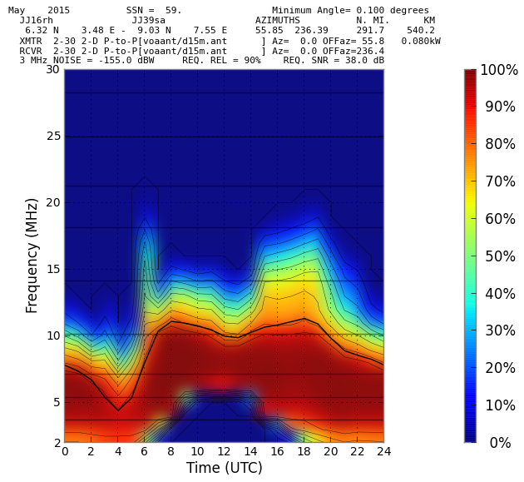
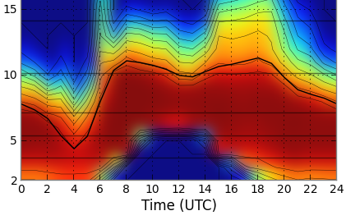
Just a quick digression….
I’ve stated that HF generally requires at least 3 working frequencies in order to provide 24/7 coverage over any given radio path. Just to illustrate this, here is an analysis of the 550km path between Lagos (the commercial capital) and Abuja (the government Capital), Nigeria, based on May 2015:
8965
6312
4031
Mike Gathergood, G4KFK May 2015

Slide 29
2G ALE - Automatic Link Establishment
ALE (automatic link establishment) according to US FED-STD-1045 or MIL-STD-188-141B
All users have unique addresses, which may be up to 15 alphanumeric characters. Signalling is 100 baud 8FSK (= 300 bits per second) signal, comprising a preamble, followed by calling address, followed by called address. Incoming calls are automatically acknowledged, even if there is no operator present to take the call.
Each radio in the network sends regular “soundings” on every available channel. Each other radio in the network uses received soundings to build a database of channel quality on every channel, on every path, at hourly intervals.
Advantages:
Operator of calling station doesn’t need to know anything about HF propagation. The radio will know the best channel for any given radio path at any time of day, of the year, and of the sunspot cycle
Disadvantages:
Preamble must be long enough for at least one whole scanning cycle
Mike Gathergood, G4KFK May 2015

Slide 30
3G ALE - Automatic Link Establishment
ALE (automatic link establishment) according to NATO STANAG 4538.
Signalling uses a modem waveform according to NATO STANAG 4539. Potentially up to 9600bps, depending on channel conditions, though ALE set-up calls are generally too short for the modems to negotiate their way up to that speed.
All radios in the network have synchronous scanning, using GPS to maintain synchronisation.
Advantages:
Call set-up is quicker because:
  We no longer need a preamble, because the calling radio knows when the called radio will be listening on the required channel
  Called and calling addresses are sent much faster
Disadvantages:
Expensive!
Requires export licence (according to Australian Government)
Mike Gathergood, G4KFK May 2015

Slide 31
Non-Voice Uses of SELCALL and ALE
SELCALL and ALE both offer user data fields after the preamble and addresses. How this is used varies between manufacturers, but typical uses include:
Text messages. Exactly the same as sending an SMS on a mobile phone!
Polling for, or responding with, latitude and longitude obtained from an attached GPS receiver
Emergency calls. GPS coordinates may also be sent, if available
Polling for, or responding with, diagnostic information. For example:
  Battery voltage on receive
  Battery voltage on transmit
  Power output
  Antenna VSWR
  Background signal level in dBm
  Received signal level in dBm
  Temperature of the radio’s heatsink
Mike Gathergood, G4KFK May 2015

Slide 32
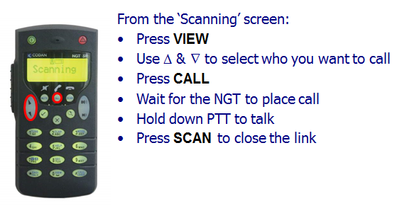
User Friendliness
SELCALL address are not user-friendly. ALE addresses are better, since they may be alphanumeric, for example: BASE1, BASE2, MOBILE1, MOBILE2
But supposing the handset has a “directory” of user names referencing their addresses?
Mike Gathergood, G4KFK May 2015

Slide 33
Digital Voice
2400bps MELP codec gives a voice quality comparable to narrowband VHF/FM, with an end-to-end delay of about 1.5 seconds. The resulting bit stream will fit into a standard SSB channel.
600bps codec gives reduced voice quality, but the bitstream can be carried in a more robust modem waveform. The result is comms quality voice over a channel which would be uncomfortable for analogue SSB.
Optional AES256 encryption.
Mike Gathergood, G4KFK May 2015

Slide 34
Frequency Hopping
Channel frequency hops within about +/- 1% of the nominal channel frequency. Hopping sequence is defined in a secure key shared by all radios in the network.
6.25, 12.5 or 25 hops per second (Codan’s implementation).
All radios in the network are synchronised using GPS. The internal clock of the radio can provide a few hours of autonomy in the event that GPS is lost.
Used to avoid deliberate jamming, and/or as an additional layer of voice security.
Mike Gathergood, G4KFK May 2015

Slide 35
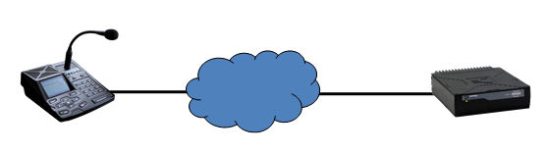
IP Remote Control
Operator no longer needs to be in same location as the Transceiver and Antenna:
Operator on ground floor, transceiver and antenna on the roof, of a high-rise building
Operator in a city, but radio equipment can be away from sources of QRM
Can run high power without EMC issues
More space for antennas
Operator can “hotdesk” from different offices
Can even use a single hop of VSAT link; operator doesn’t even need to be in the same country
Mike Gathergood, G4KFK May 2015

Slide 36
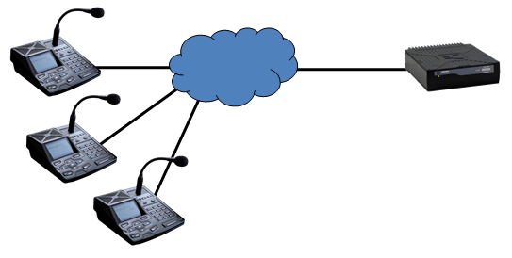
Multiple Control Points for 1 Radio
Several users can share a single transceiver:
Each user may have his own SELCALL or ALE address; only the desk console with the correct address will ring on incoming call
Group address; all desk consoles will ring on incoming call
Other users will see “system busy” on their screen
Mike Gathergood, G4KFK May 2015

Slide 37
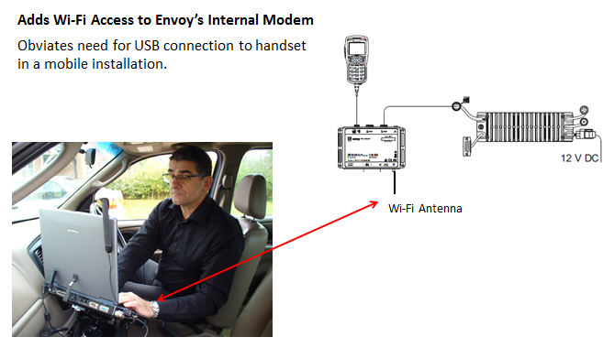
WiFi Access to HF Data Modem
Mike Gathergood, G4KFK May 2015

Slide 38
WiFi Access to HF Data Modem
Mike Gathergood, G4KFK May 2015

Slide 39
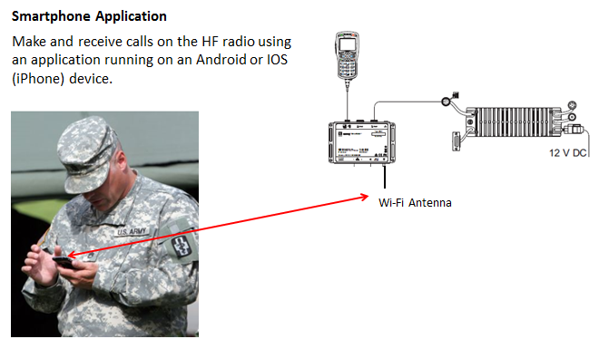
WiFi Access for Smartphone App
Mike Gathergood, G4KFK May 2015

Slide 40
Manufacturers
Codan, Australia www.codanradio.com
Barrett, Australia www.barrettcommunications.com.au
Micom, Israel www.elbitsystems.com
Vertex, Japan www.vertex-standard-emea.com
Harris, USA www.harris.com
Datron, USA www.dtwc.com
Sunair, USA www.sunairhf.com
SGC www.sgcworld.com
Icom www.icom.co.jp
Mike Gathergood, G4KFK May 2015

