Slide 1
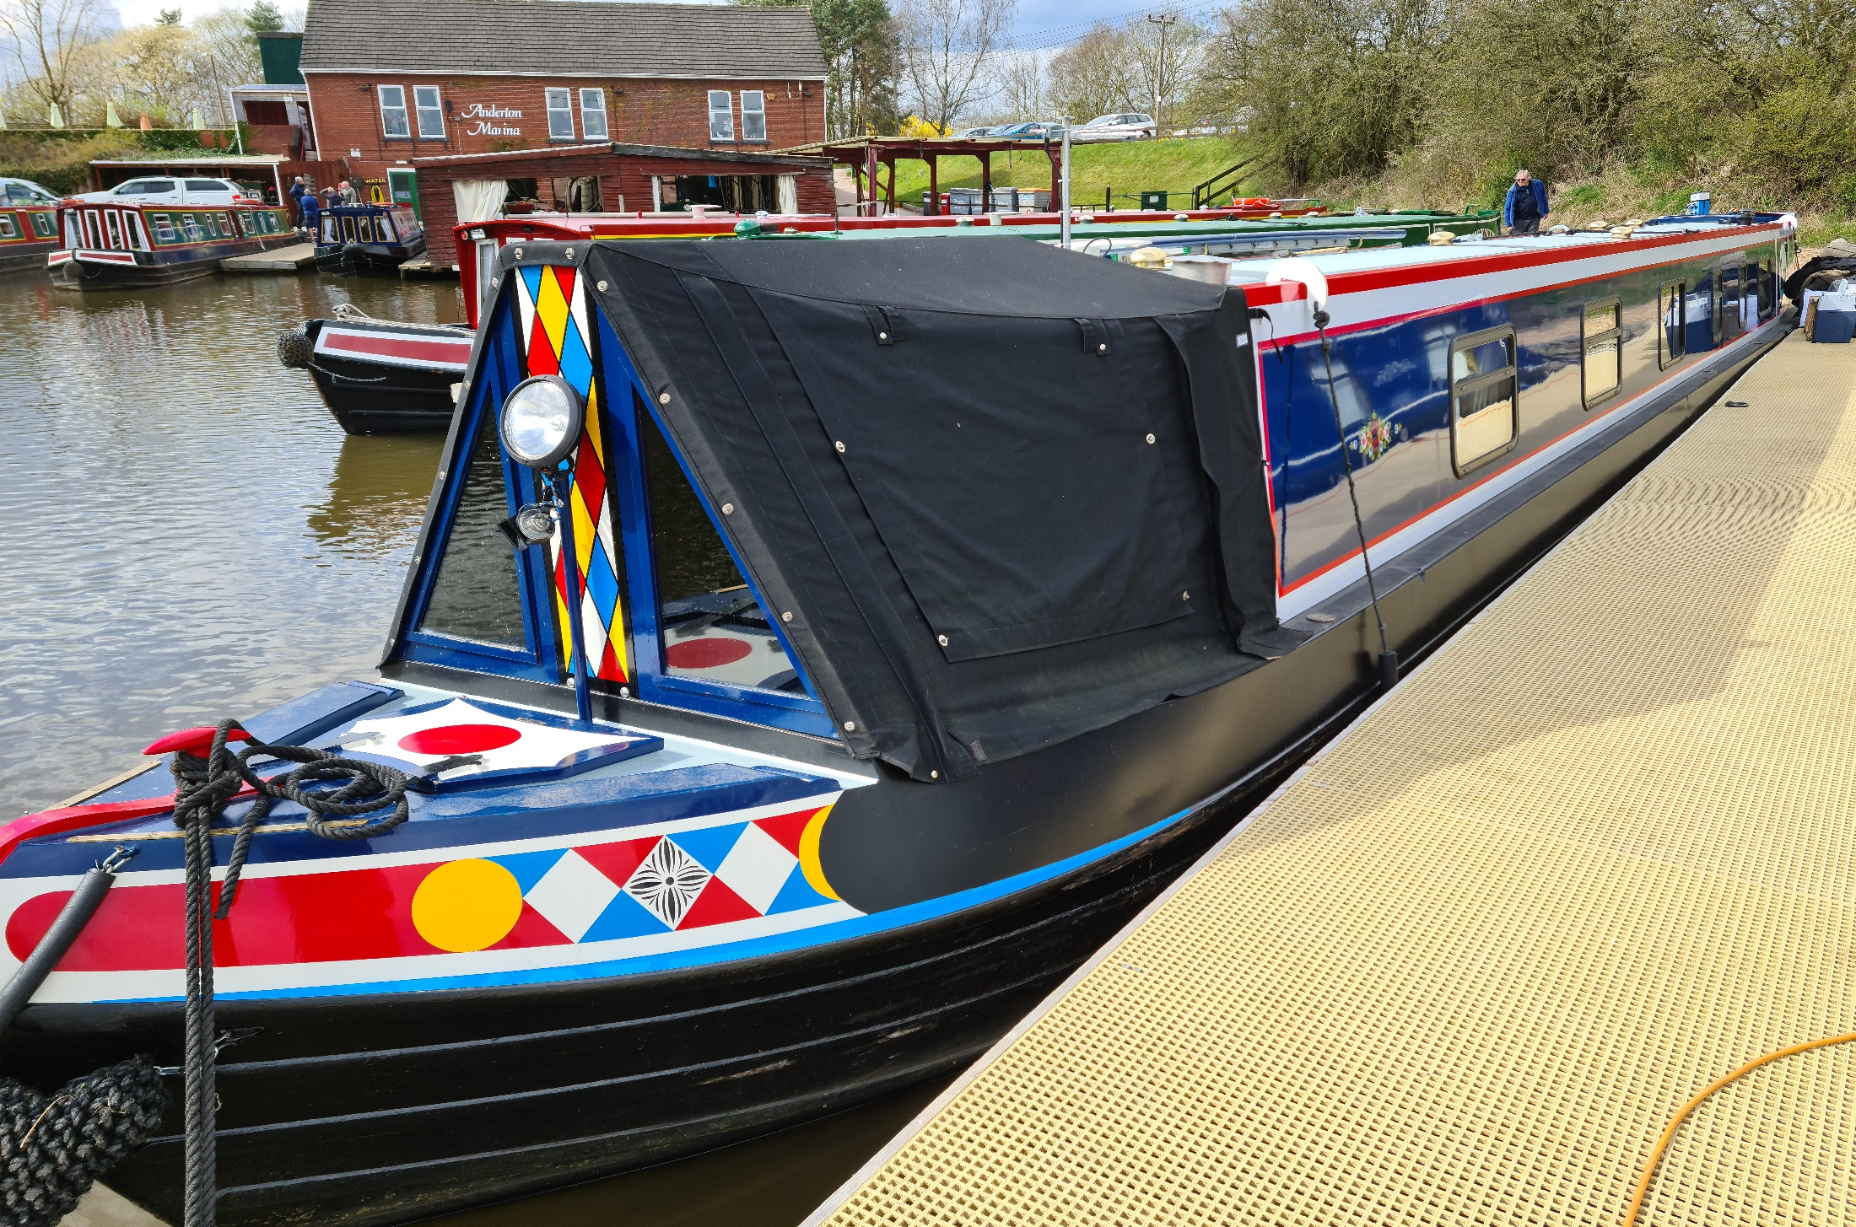
Operating from a Canal Boat
Mike Gathergood, G4KFK October 2022

Slide 2
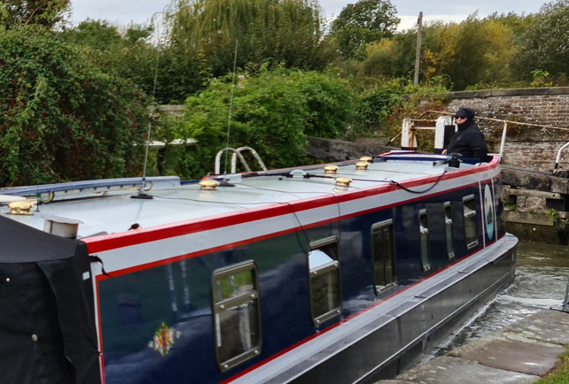
VHF and UHF Verticals are easy – magmounts!
2m 7/8λ
4m 1/4λ
Mike Gathergood, G4KFK October 2022

Slide 3
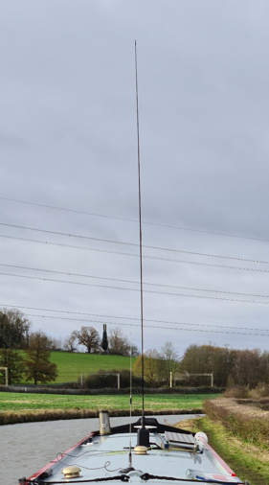
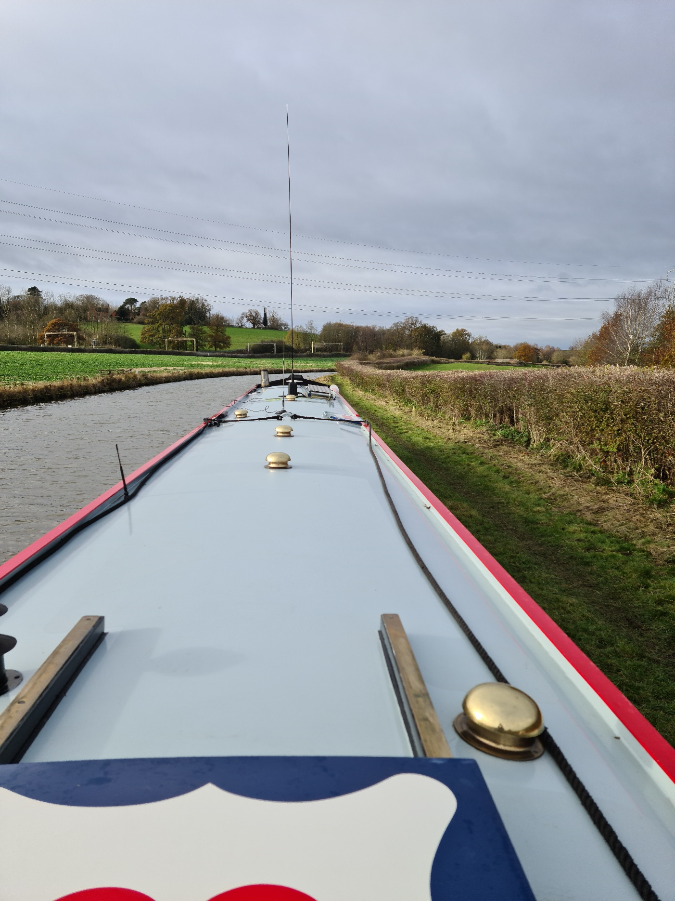
Modifying a Triple Magmount for HF
3m Whip
Codan Tuner
Mike Gathergood, G4KFK October 2022

Slide 4
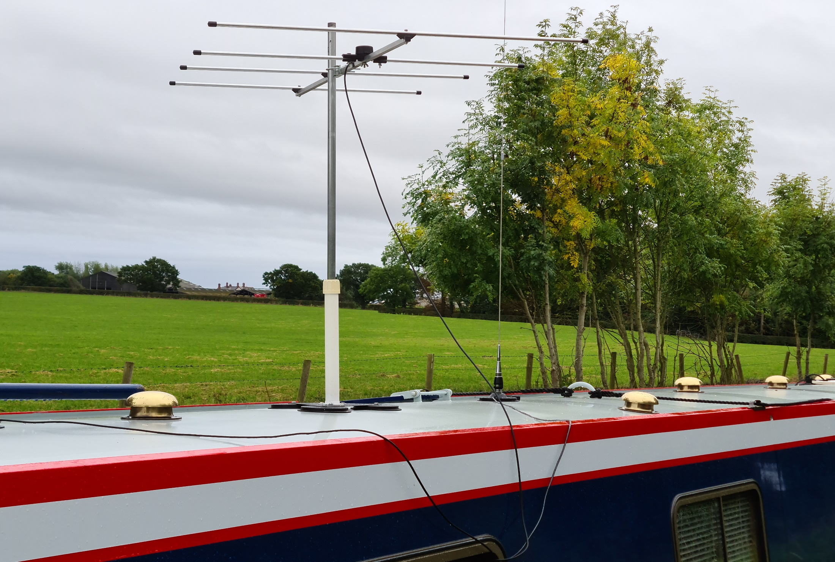
Modifying a Triple Magmount for a 2m Yagi
4ft x 1” Aluminium Pole
Base from household fan
Mike Gathergood, G4KFK October 2022

Slide 5
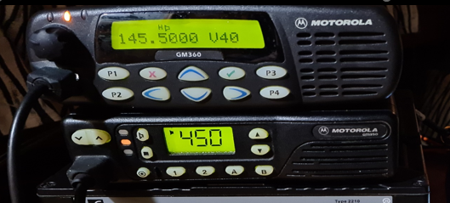
Motorolas for 2m and 4m FM, Codan for HF
Mike Gathergood, G4KFK October 2022

Slide 6
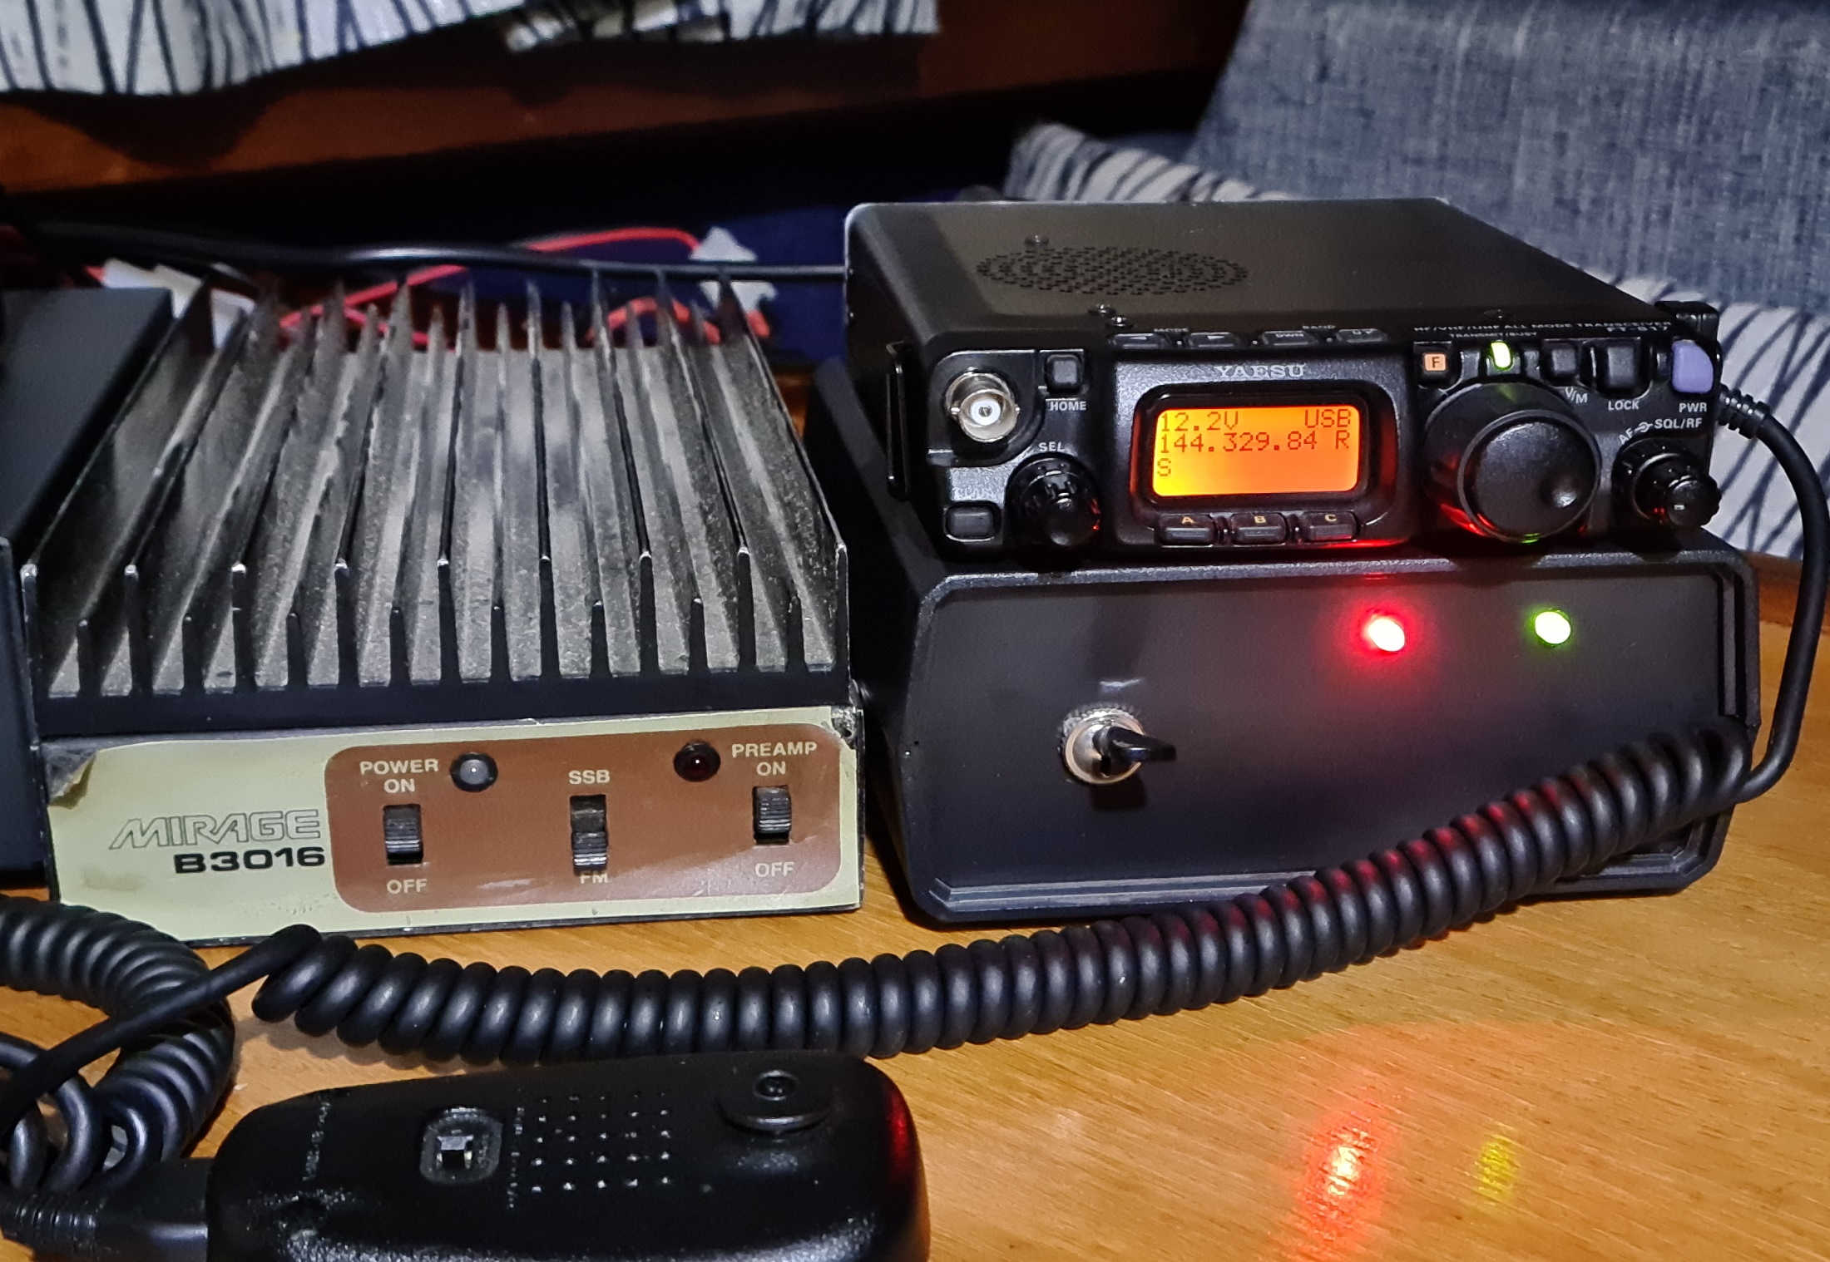
Yaesu FT-817ND and Mirage Amp for 2m SSB
Mike Gathergood, G4KFK October 2022

Slide 7
Stations worked on UKAC 2m, Oct 4th 2022
04 October 2022 | 2112 | 2114 | 144.385 | J3E | 50W | GW8ASD | 57017 | 56051 | IO83LB
04 October 2022 | 2107 | 2109 | 144.340 | J3E | 50W | G0XDI | 55016 | 53111 | IO91RQ
04 October 2022 | 2102 | 2104 | 144.278 | J3E | 50W | G8ZRE | 53015 | 53043 | IO83NE
04 October 2022 | 2056 | 2100 | 144.235 | J3E | 50W | GI4SNA | 53014 | 41124 | IO64XM
04 October 2022 | 2034 | 2035 | 144.189 | J3E | 50W | G4JLG | 59013 | 56031 | IO83TM
04 October 2022 | 2030 | 2032 | 144.273 | J3E | 50W | M5MC/P | 55012 | 59124 | JO02QI
04 October 2022 | 1954 | 1955 | 144.335 | J3E | 50W | M0BB | 55011 | 53053 | IO91PK
04 October 2022 | 1951 | 1953 | 144.245 | J3E | 50W | G3YKI | 55010 | 52016 | IO82QL
04 October 2022 | 1947 | 1948 | 144.150 | J3E | 50W | M1MHZ | 57009 | 59048 | IO92WV
04 October 2022 | 1943 | 1944 | 144.360 | J3E | 50W | G4CLA | 57008 | 59113 | IO92JL
04 October 2022 | 1939 | 1940 | 144.178 | J3E | 50W | GD8EXI | 55007 | 53052 | IO74PC
04 October 2022 | 1936 | 1938 | 144.169 | J3E | 50W | G0SKA | 57006 | 55035 | IO91OQ
04 October 2022 | 1927 | 1928 | 144.365 | J3E | 50W | G0JSB | 54005 | 52010 | IO83KJ
04 October 2022 | 1918 | 1919 | 144.366 | J3E | 50W | G4AFF | 57004 | 55028 | JO02LO
04 October 2022 | 1916 | 1917 | 144.383 | J3E | 50W | G4RUL/P | 53003 | 57025 | JO00DR
04 October 2022 | 1905 | 1906 | 144.173 | J3E | 50W | G0ODQ | 55002 | 55007 | IO91MR
04 October 2022 | 1902 | 1903 | 144.332 | J3E | 50W | M1EYP/P | 59001 | 59001 | IO83WE
04 October 2022 | 1810 | 1811 | 145.425 | F3E | 25W | G0CCT | 57003 | 53006 | IO83KI
04 October 2022 | 1807 | 1808 | 145.350 | F3E | 25W | M6PMA | 55002 | 53004 | IO83LK
04 October 2022 | 1804 | 1805 | 145.400 | F3E | 25W | M1EYP/P | 59001 | 59002 | IO83WE
Mike Gathergood, G4KFK October 2022

Slide 8
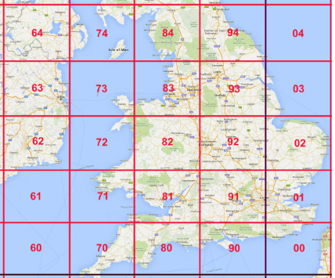
Squares worked on UKAC 2m, Oct 4th 2022
✓
✓
✓
*
✓
✓
✓
✓
✓
Mike Gathergood, G4KFK October 2022

Slide 9
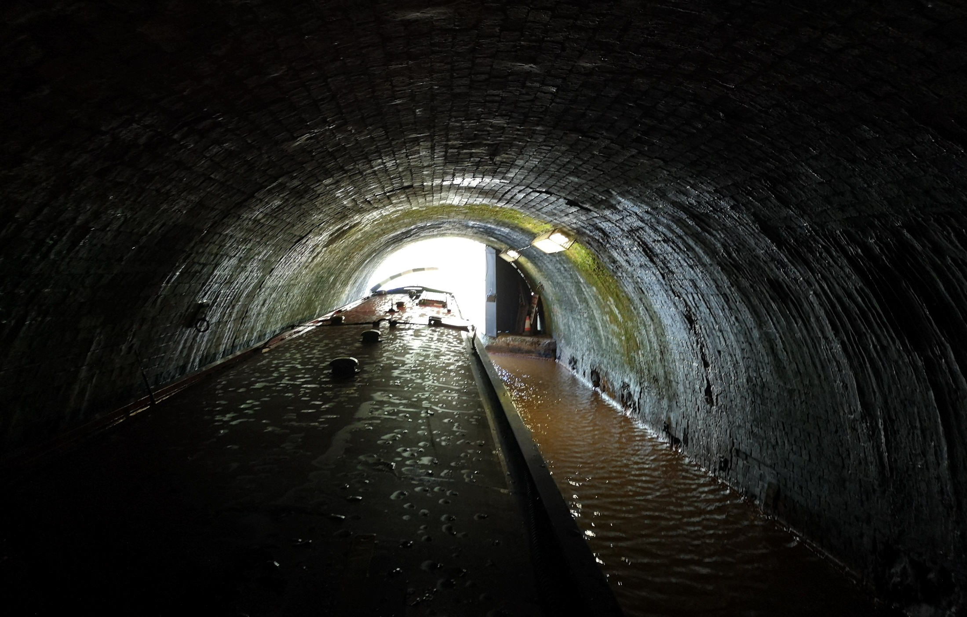
There are some places where radio won’t work
Mike Gathergood, G4KFK October 2022

